Slide 1
base_low
Pipeline: Low
Vessel Pathway: Base
Port Pathway: Base

Slide 2
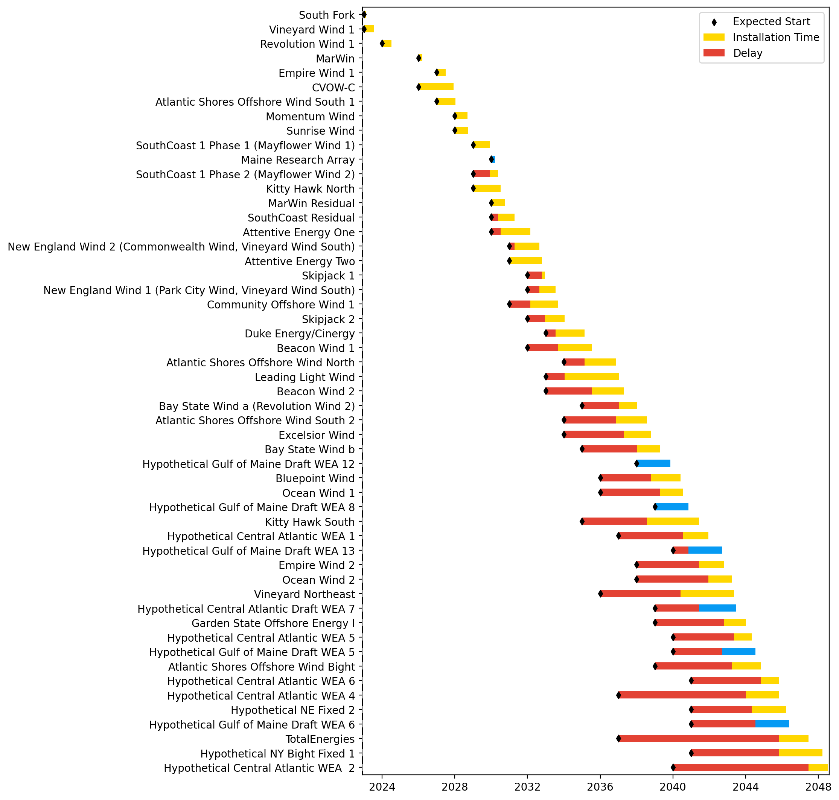
Full Gantt

Slide 3
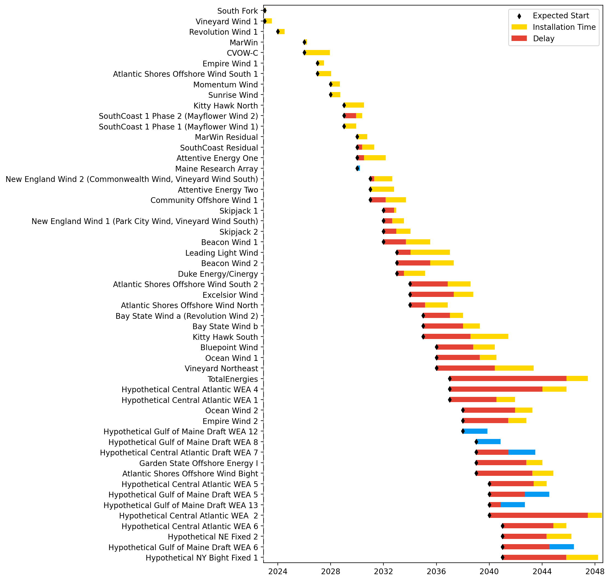
Sorted Full Gantt

Slide 4
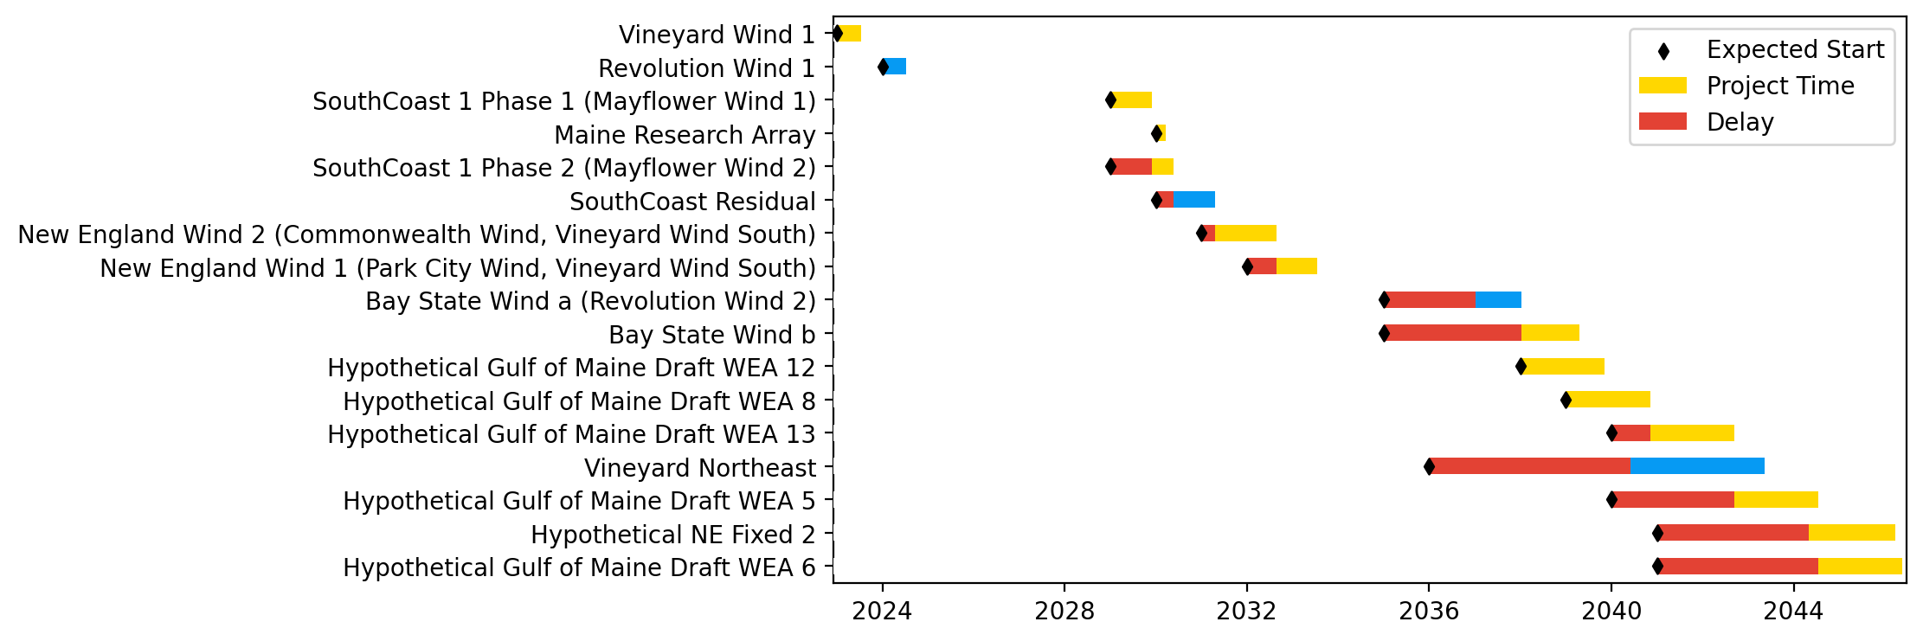
New England Gantt

Slide 5
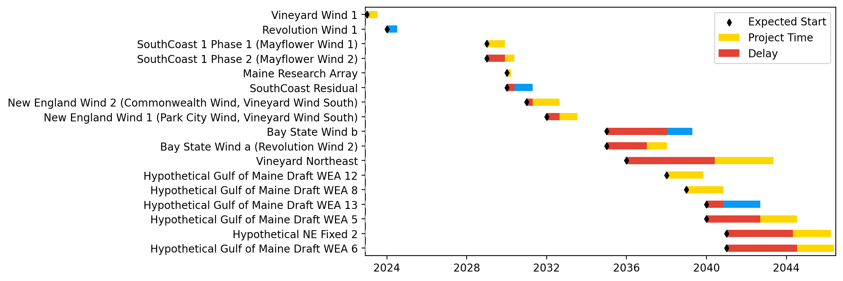
Sorted New England Gantt

Slide 6
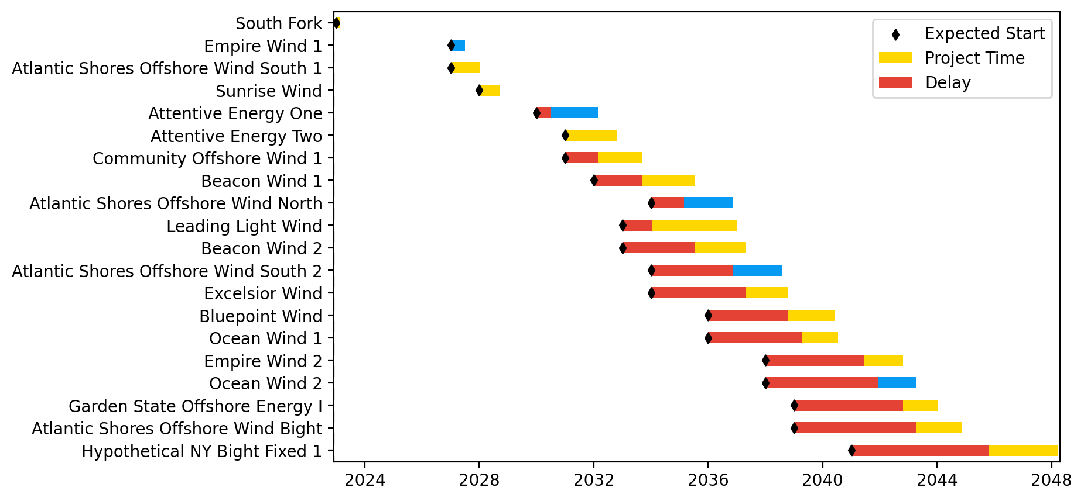
New York/New Jersey Gantt

Slide 7
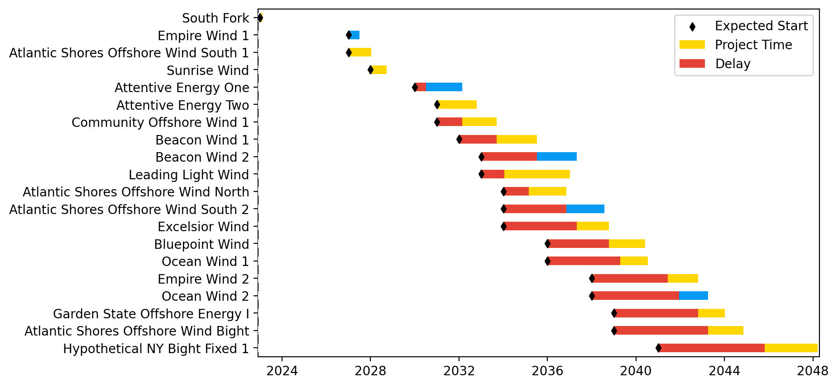
Sorted New York/New Jersey Gantt

Slide 8
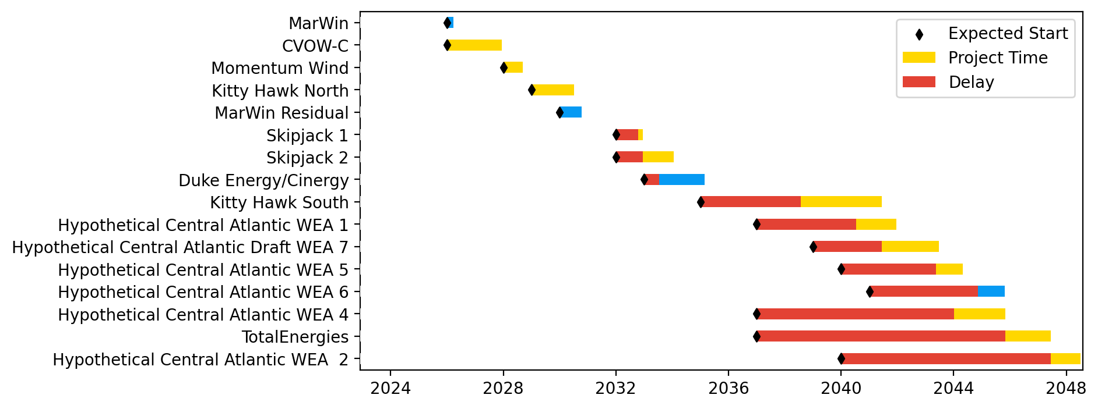
Midatlantic Gantt

Slide 9
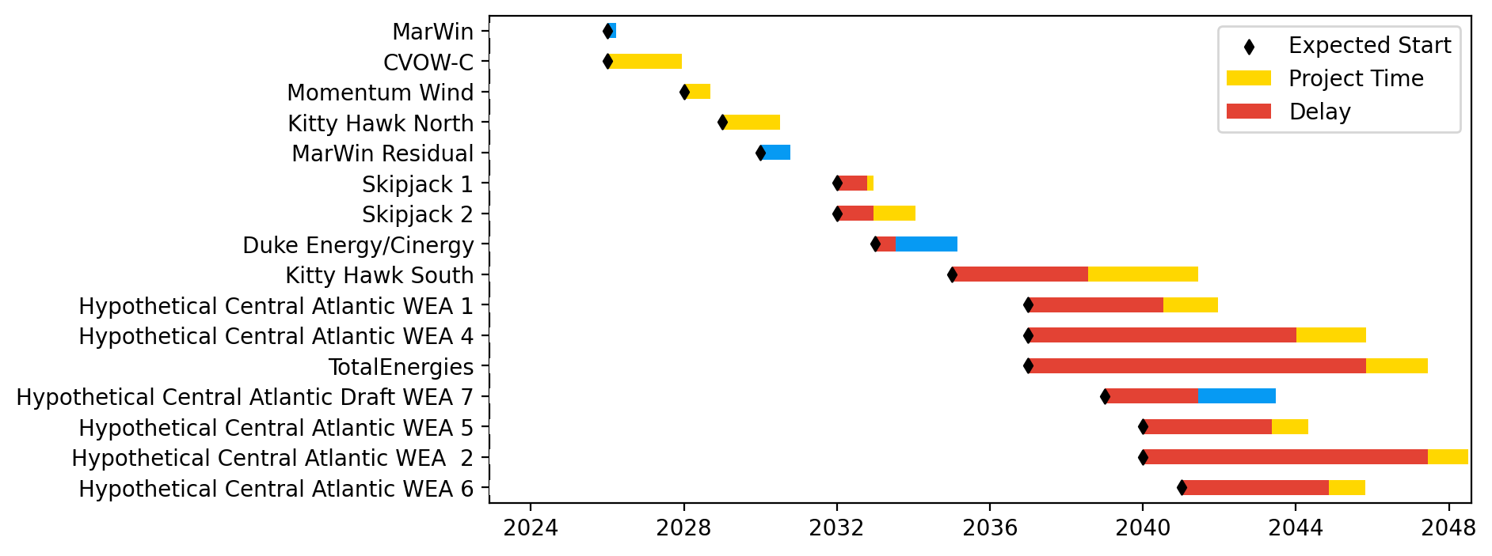
Sorted Midatlantic Gantt

Slide 10
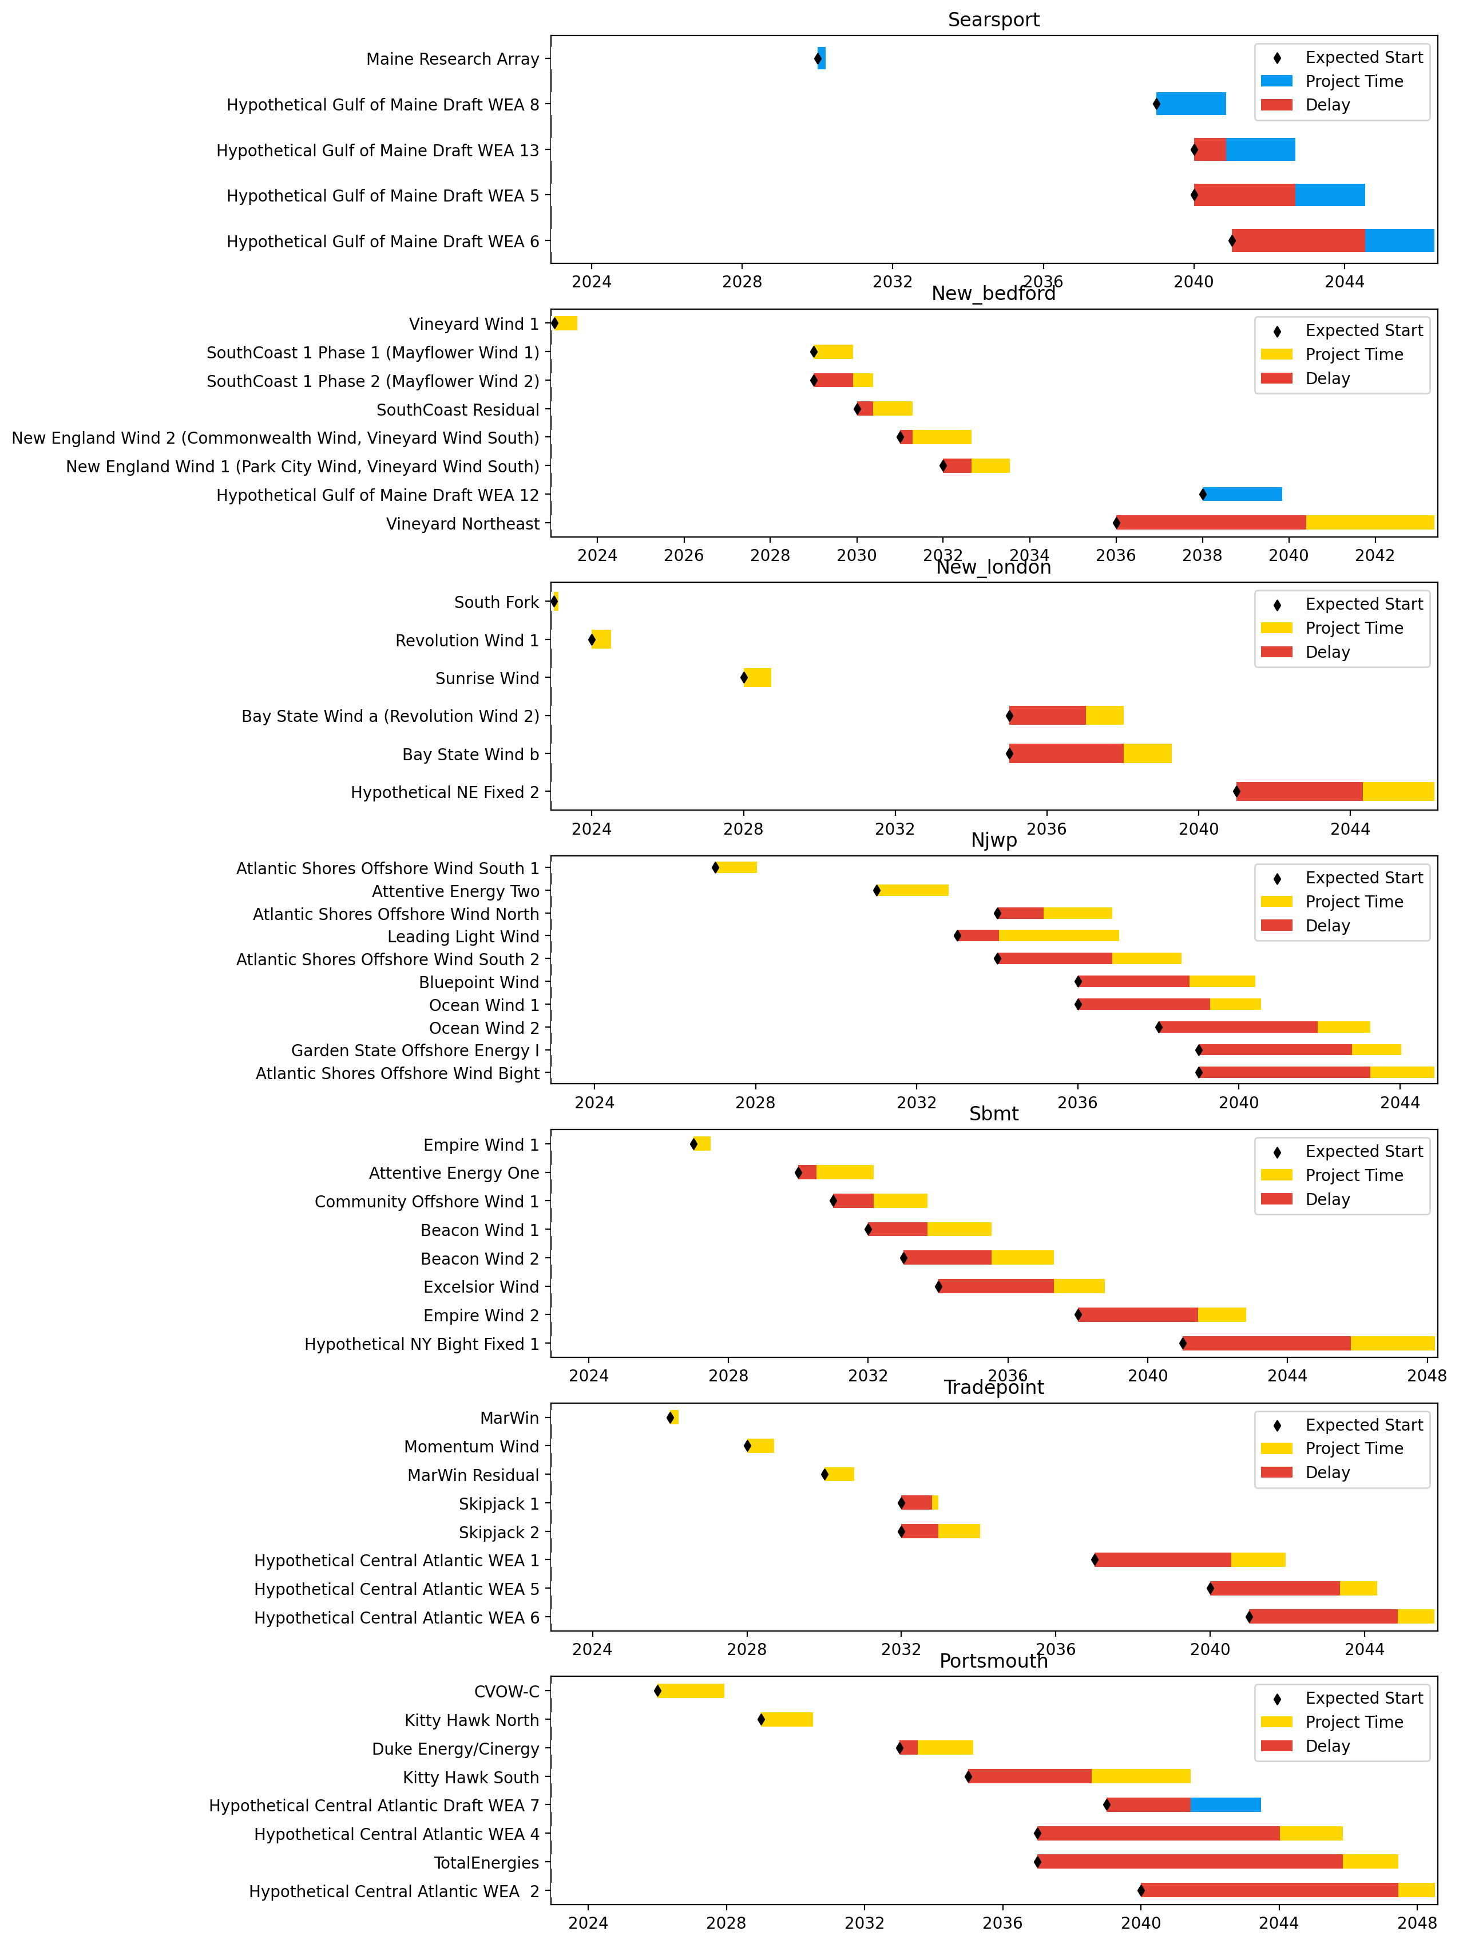
Port Gantts

Slide 11
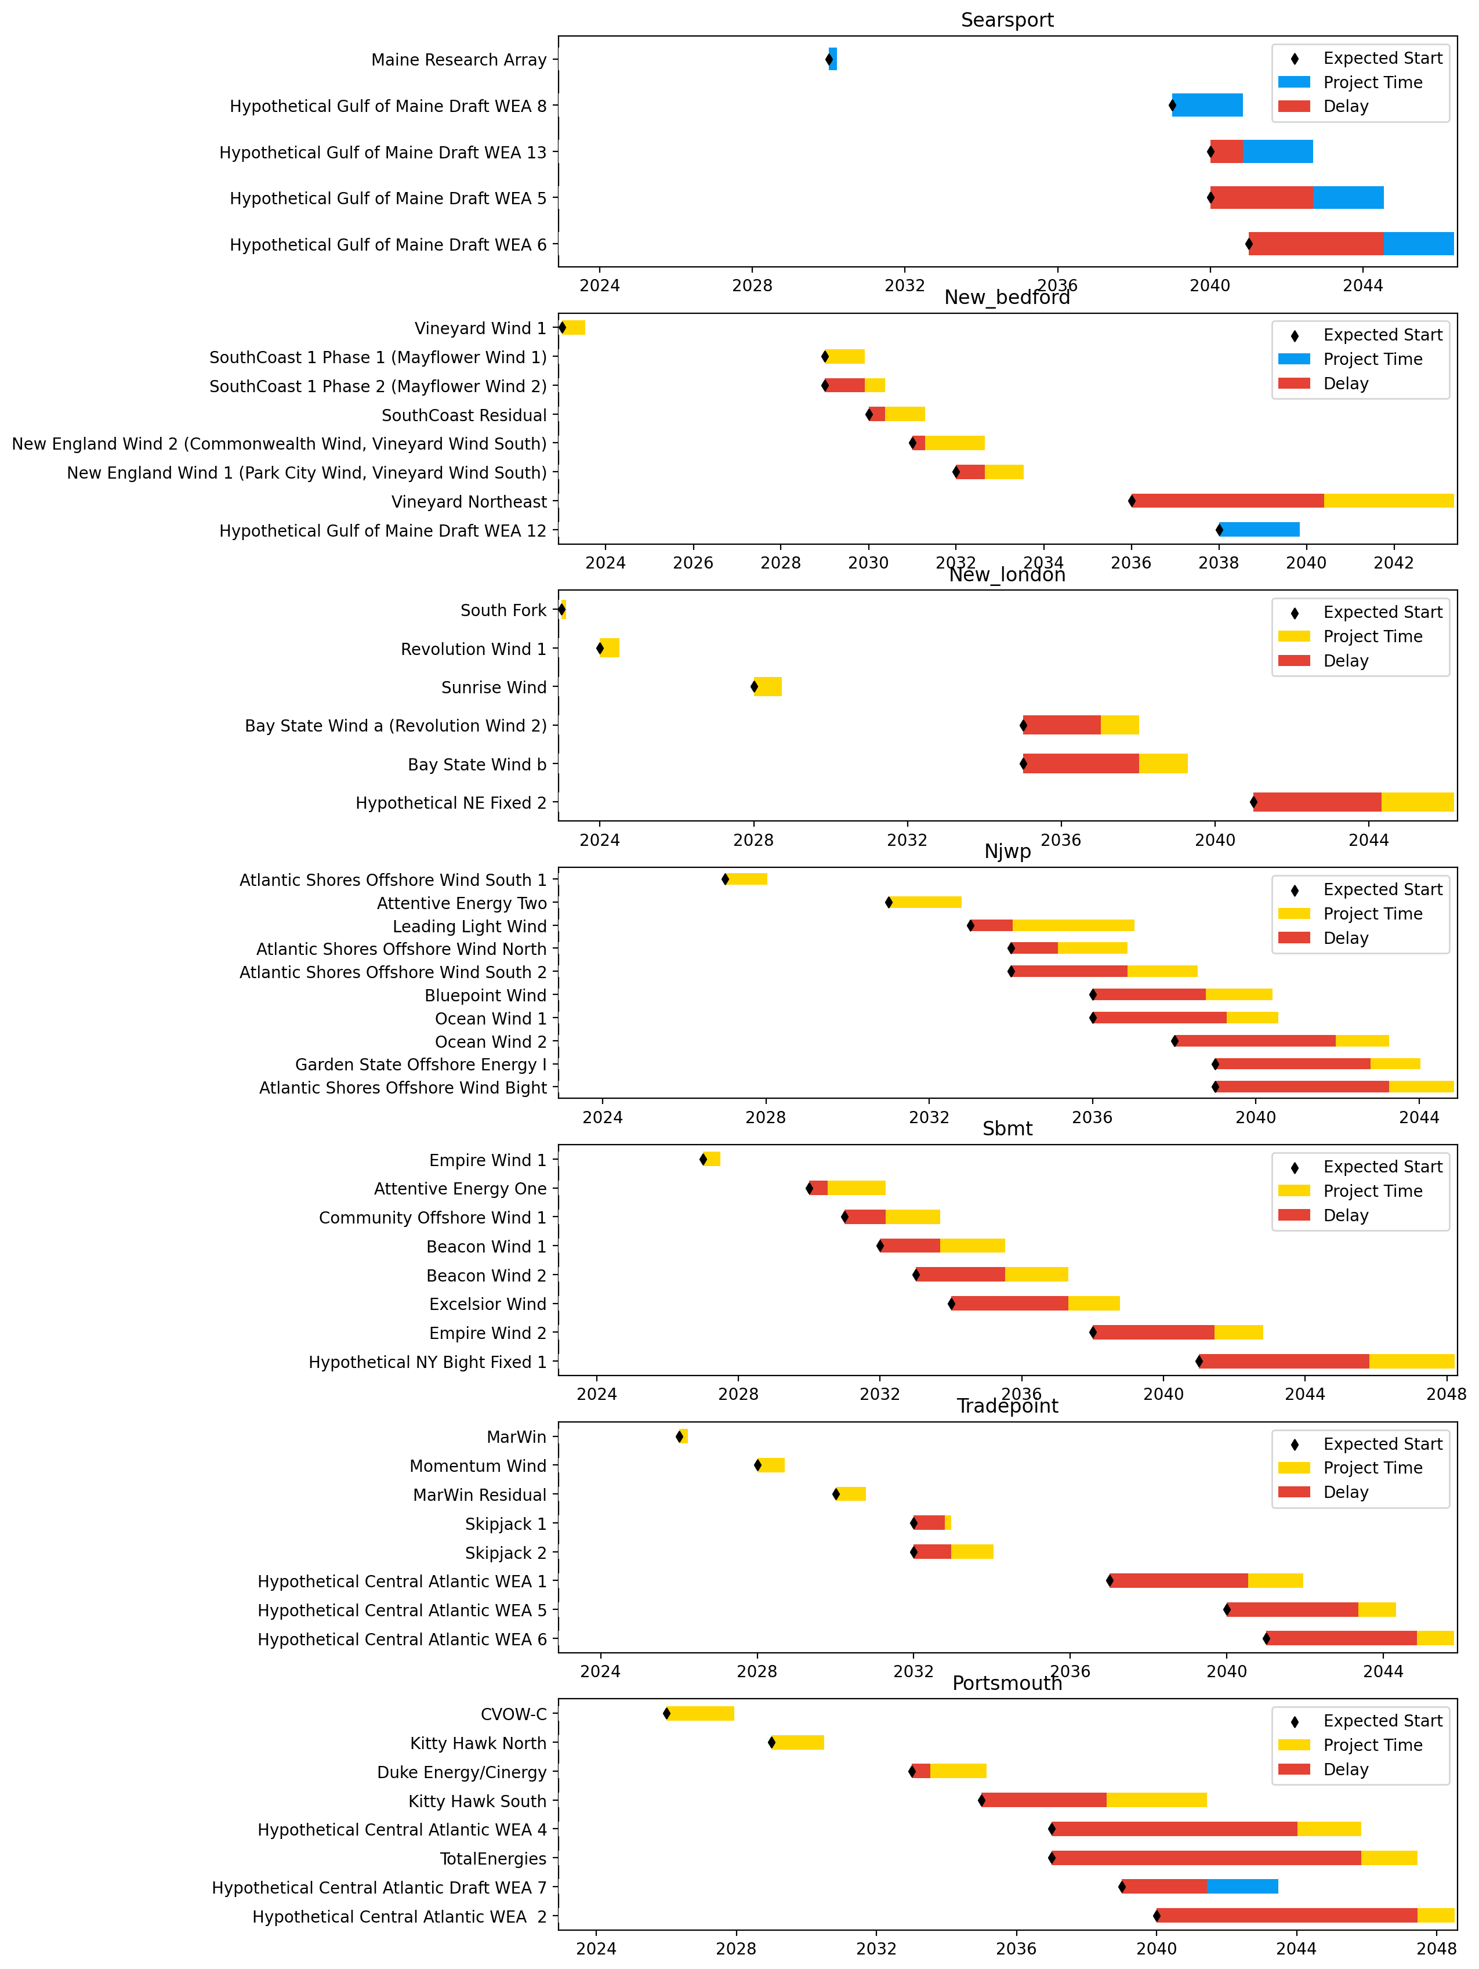
Sorted Port Gantts

Slide 12
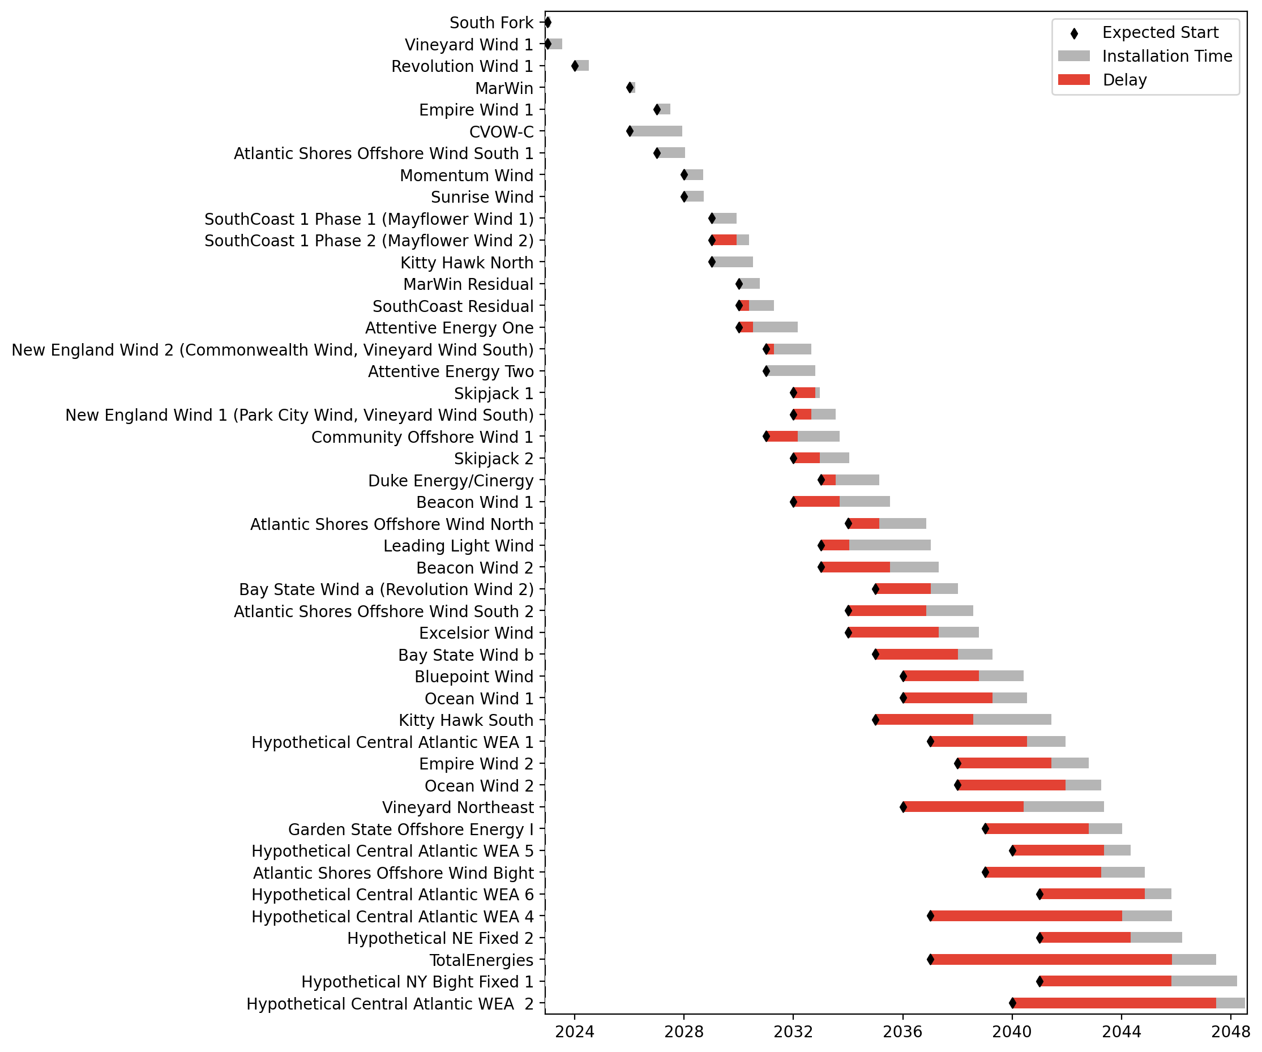
Fixed Gantt

Slide 13
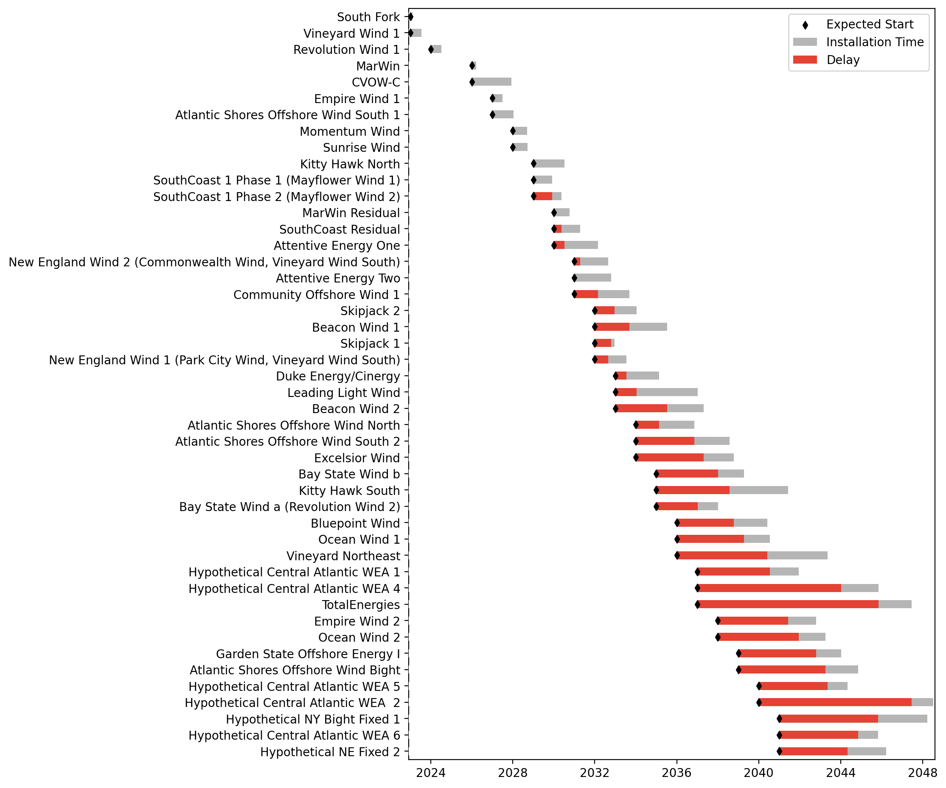
Sorted Fixed Gantt

Slide 14
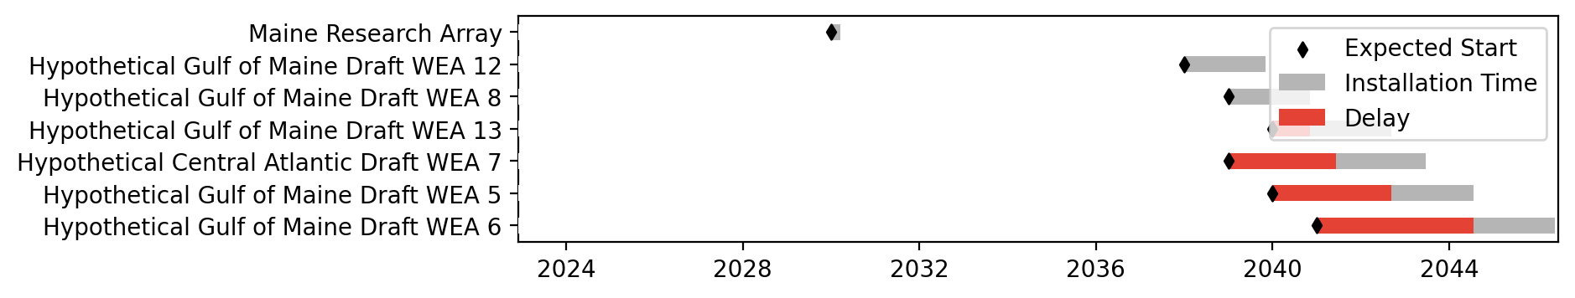
Floating Gantt

Slide 15
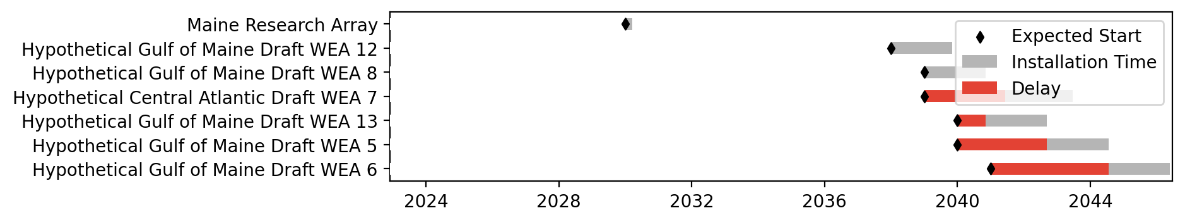
Sorted Floating Gantt

Slide 16
base_baseline
Pipeline: Baseline
Vessel Pathway: Base
Port Pathway: Base

Slide 17
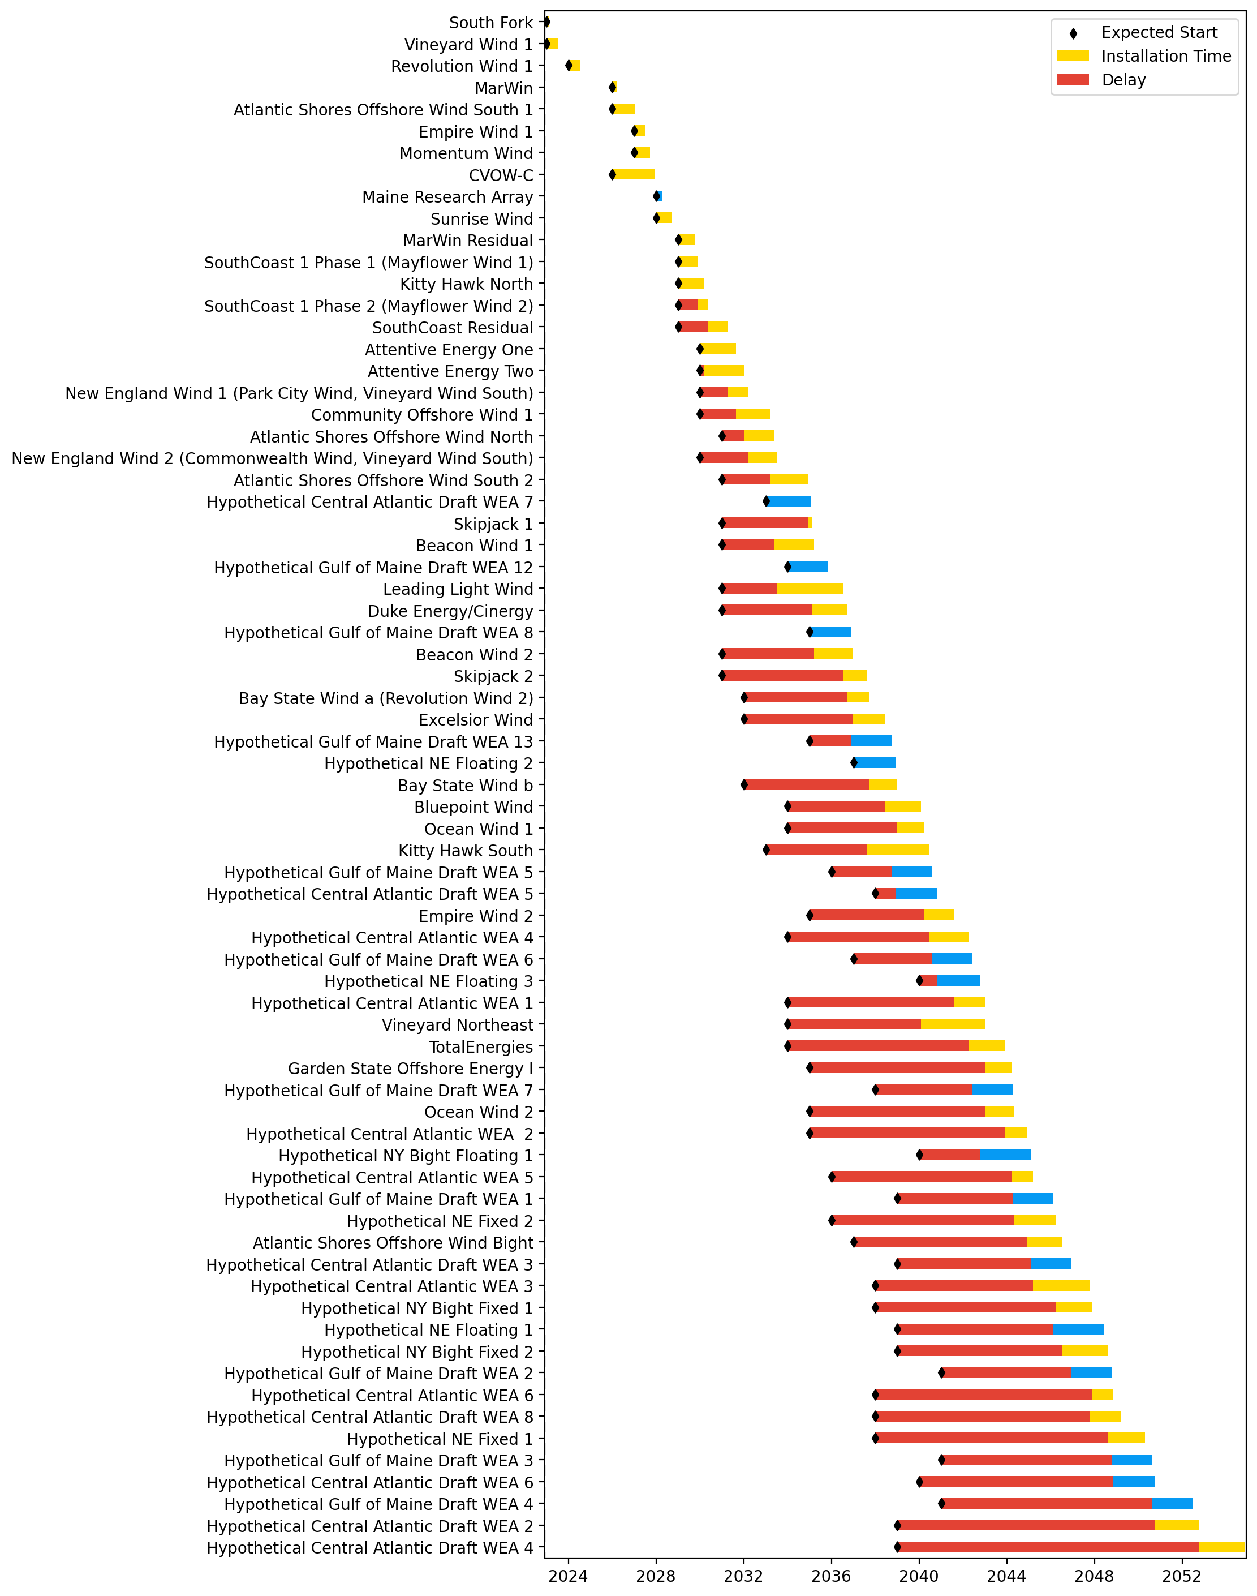
Full Gantt

Slide 18
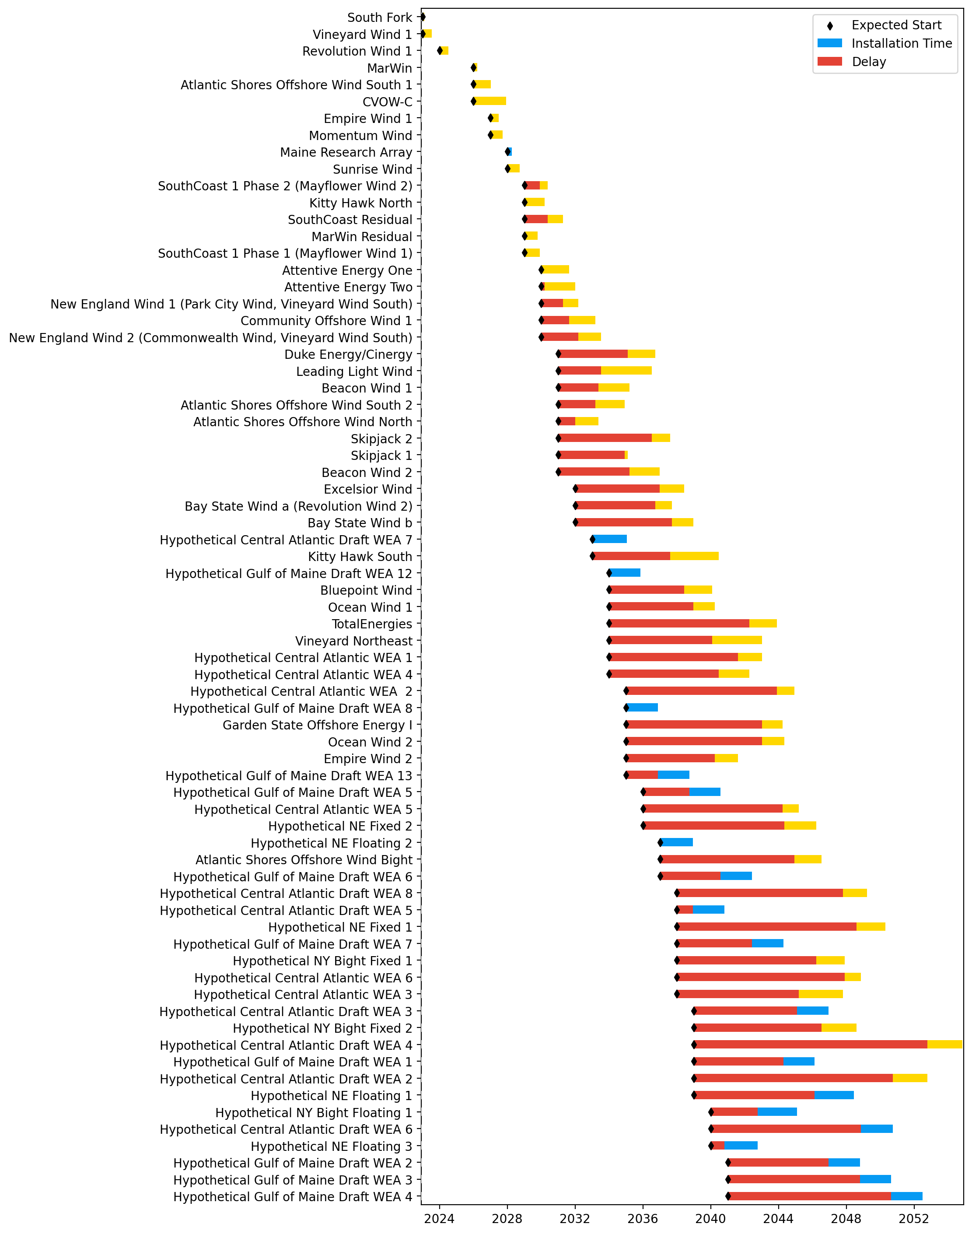
Sorted Full Gantt

Slide 19
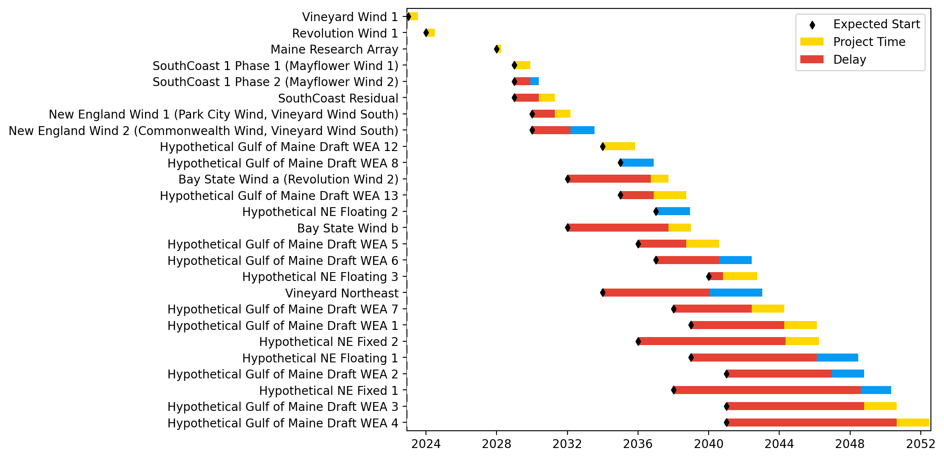
New England Gantt

Slide 20
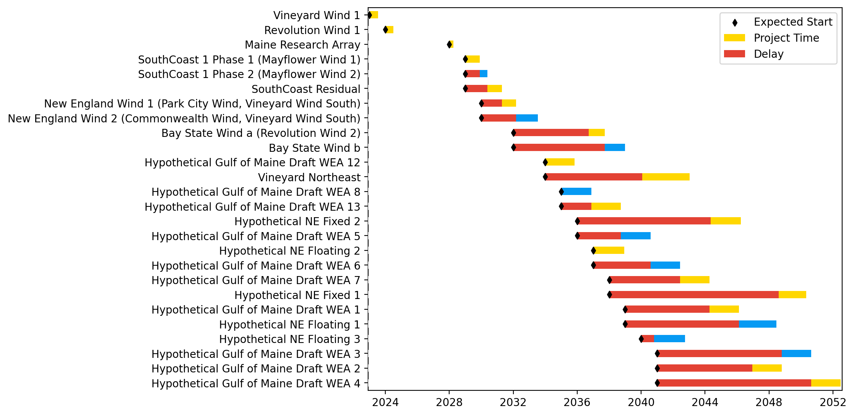
Sorted New England Gantt

Slide 21
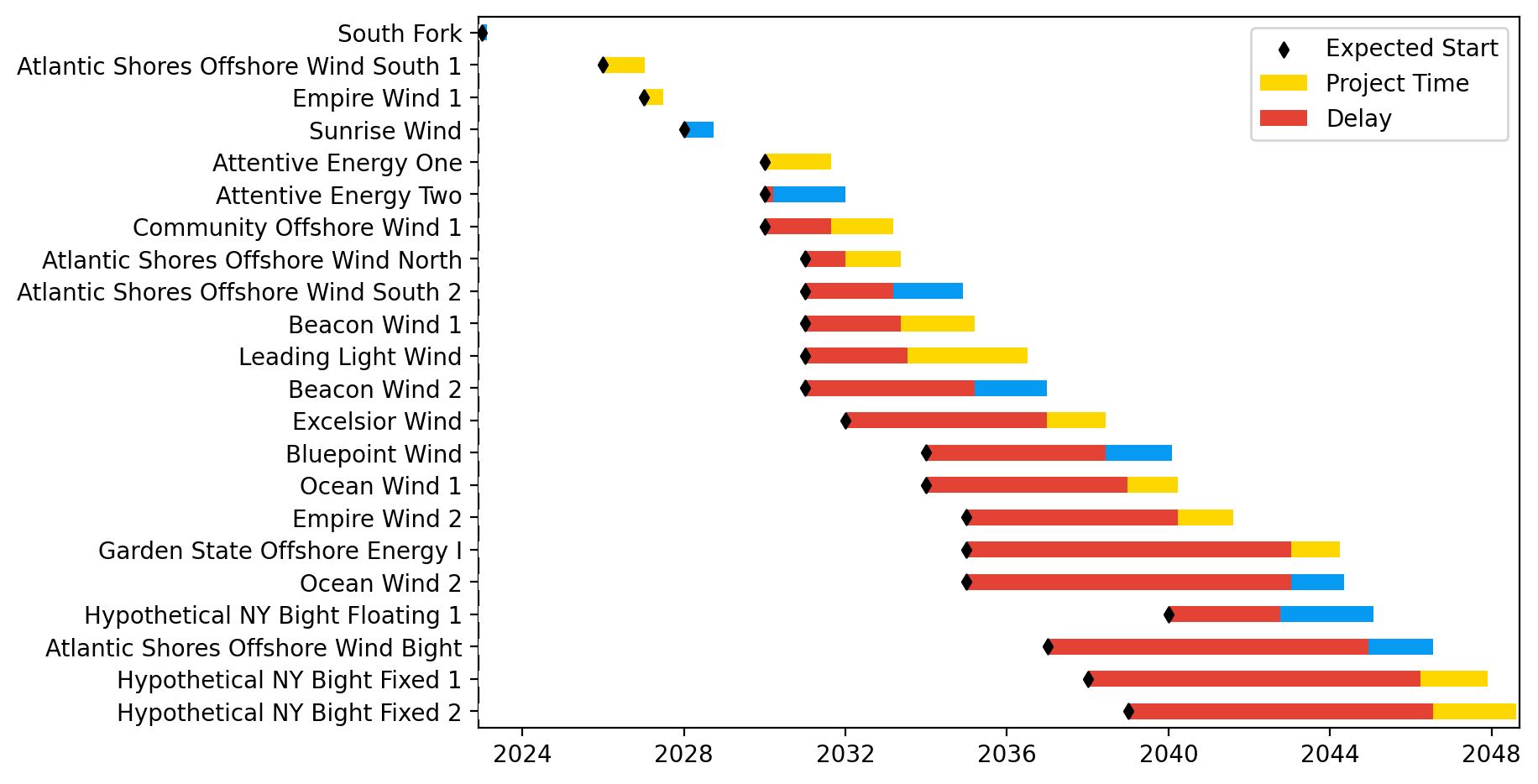
New York/New Jersey Gantt

Slide 22
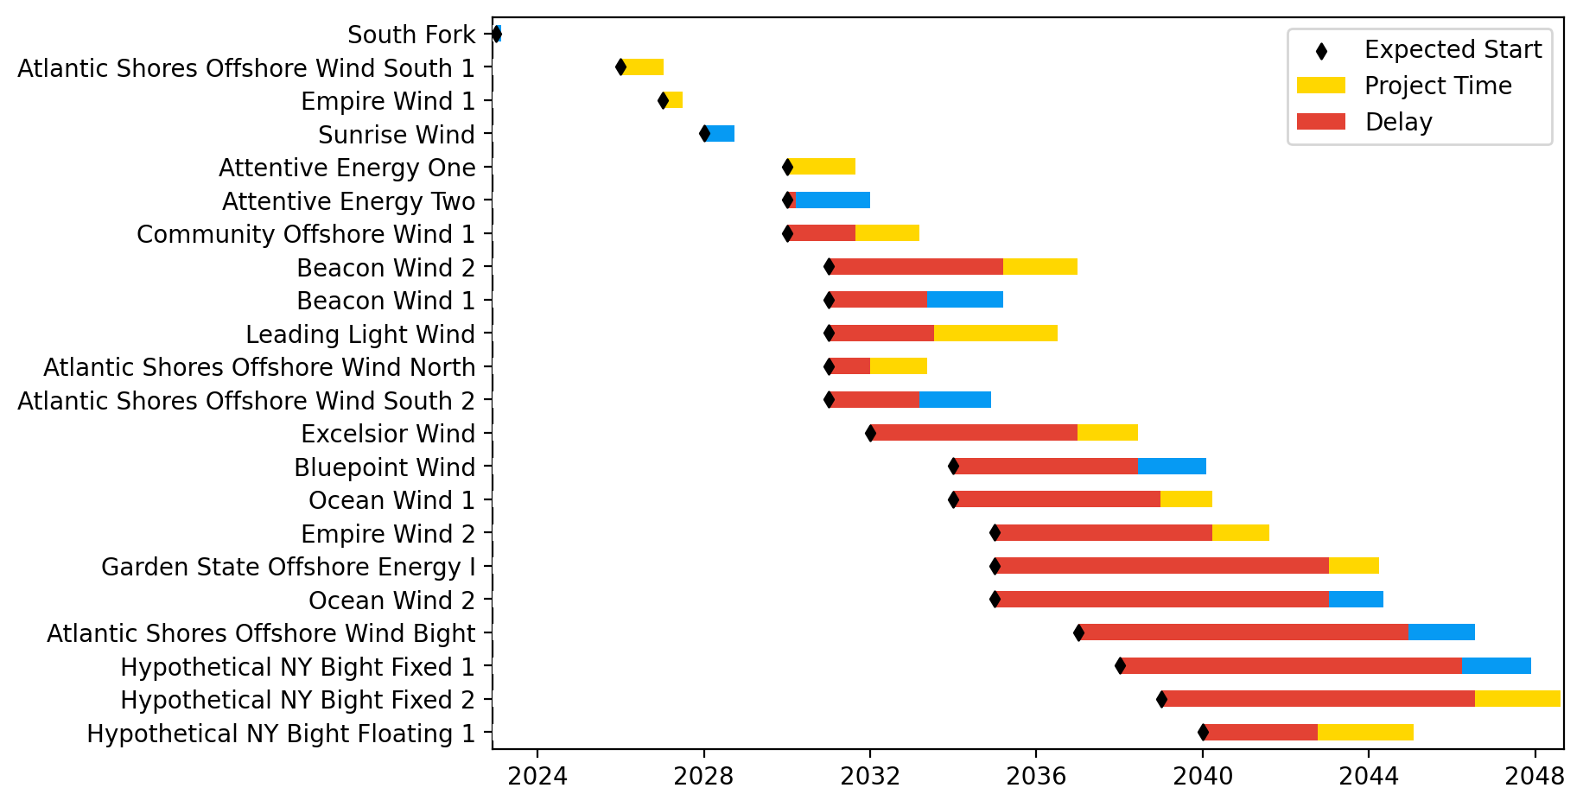
Sorted New York/New Jersey Gantt

Slide 23
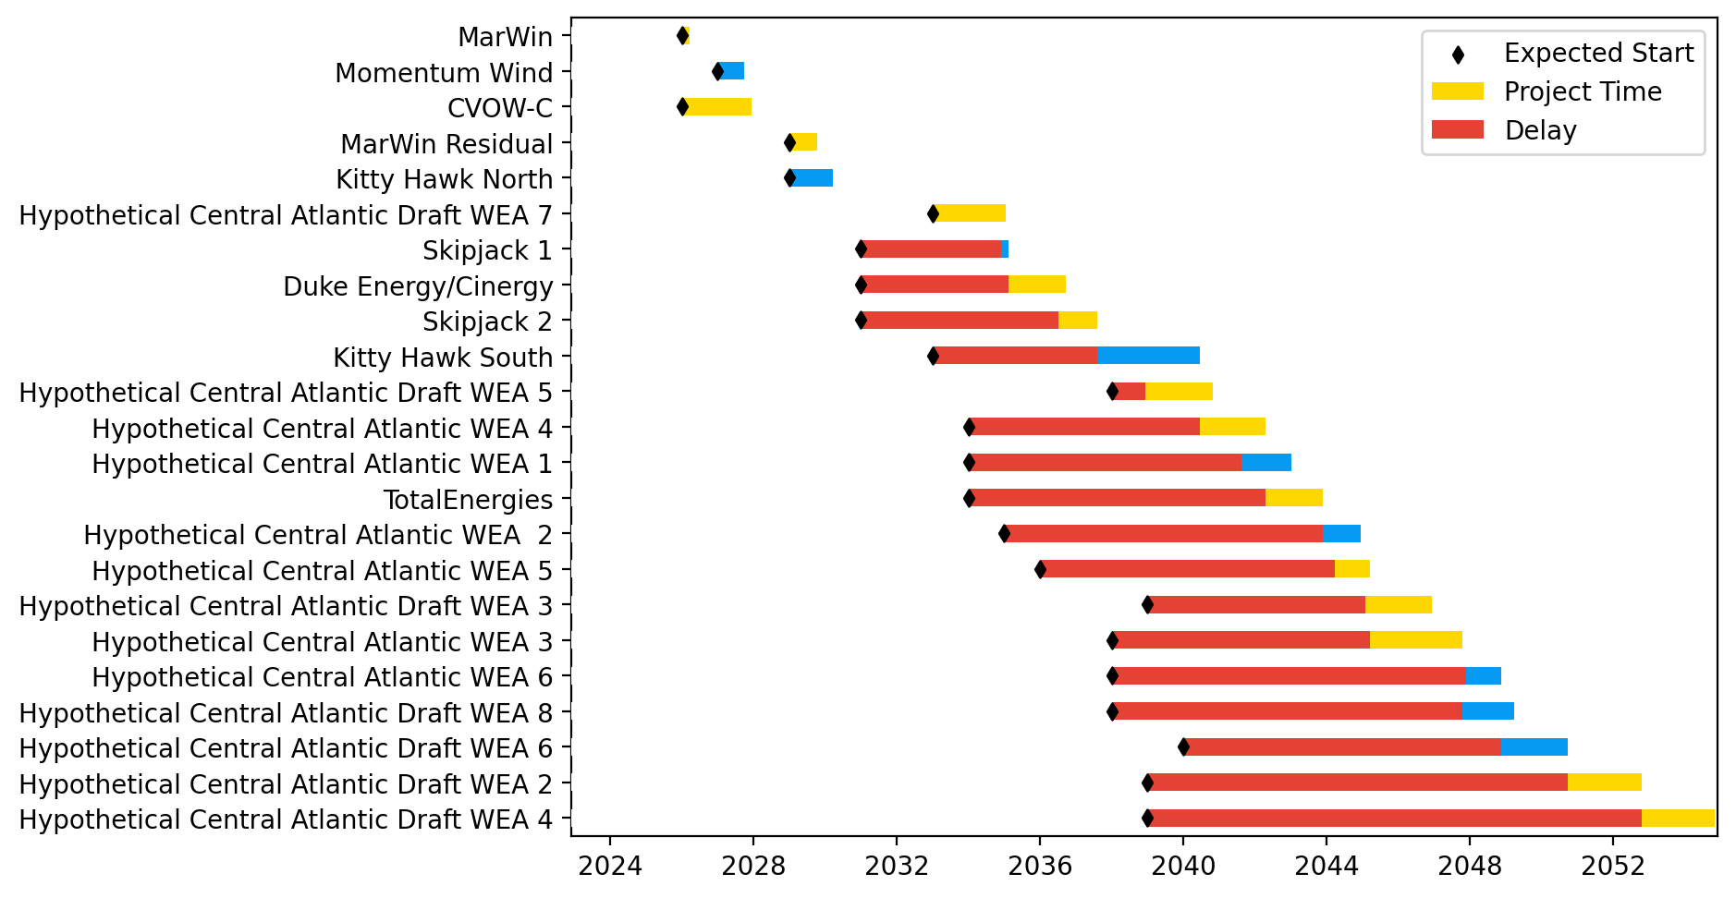
Midatlantic Gantt

Slide 24
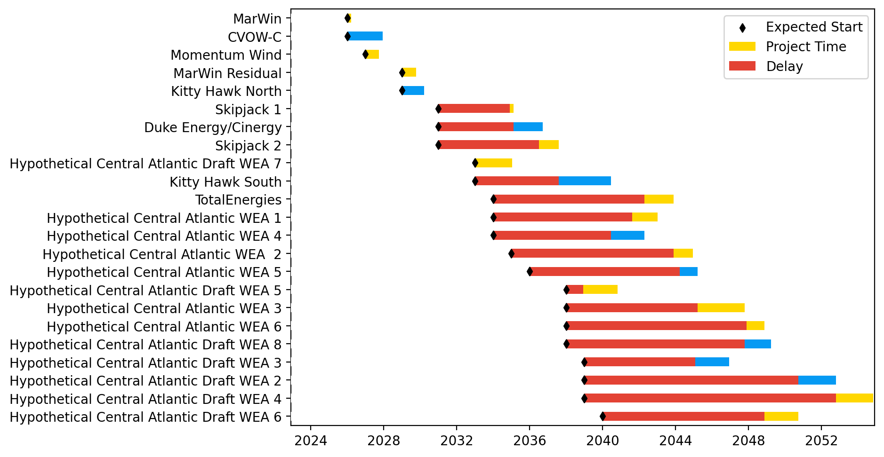
Sorted Midatlantic Gantt

Slide 25
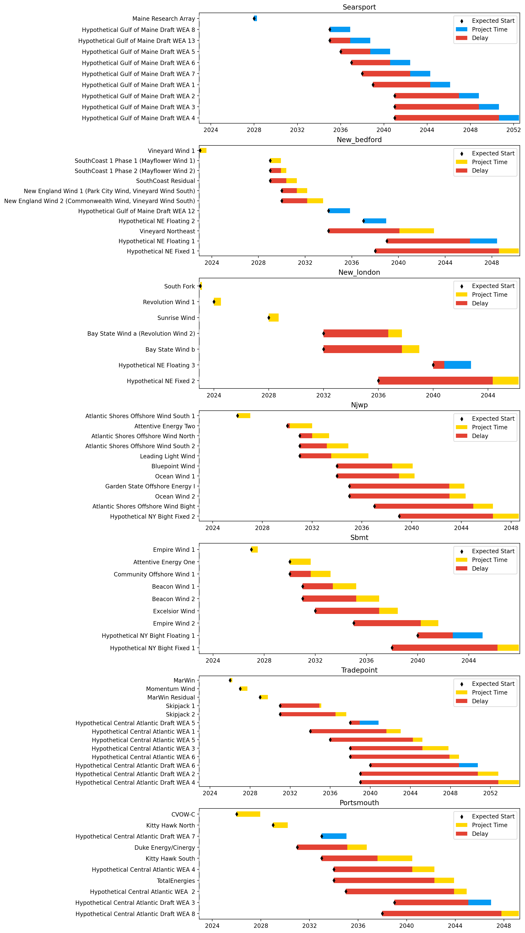
Port Gantts

Slide 26
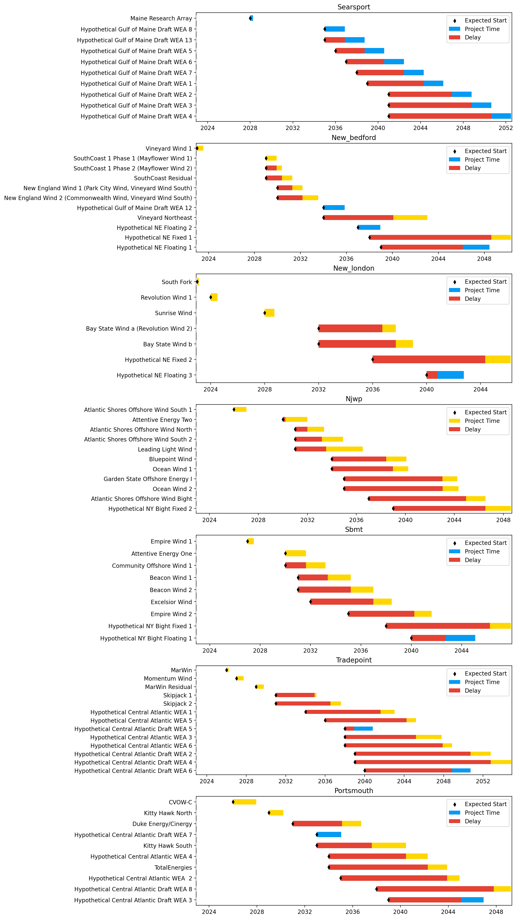
Sorted Port Gantts

Slide 27
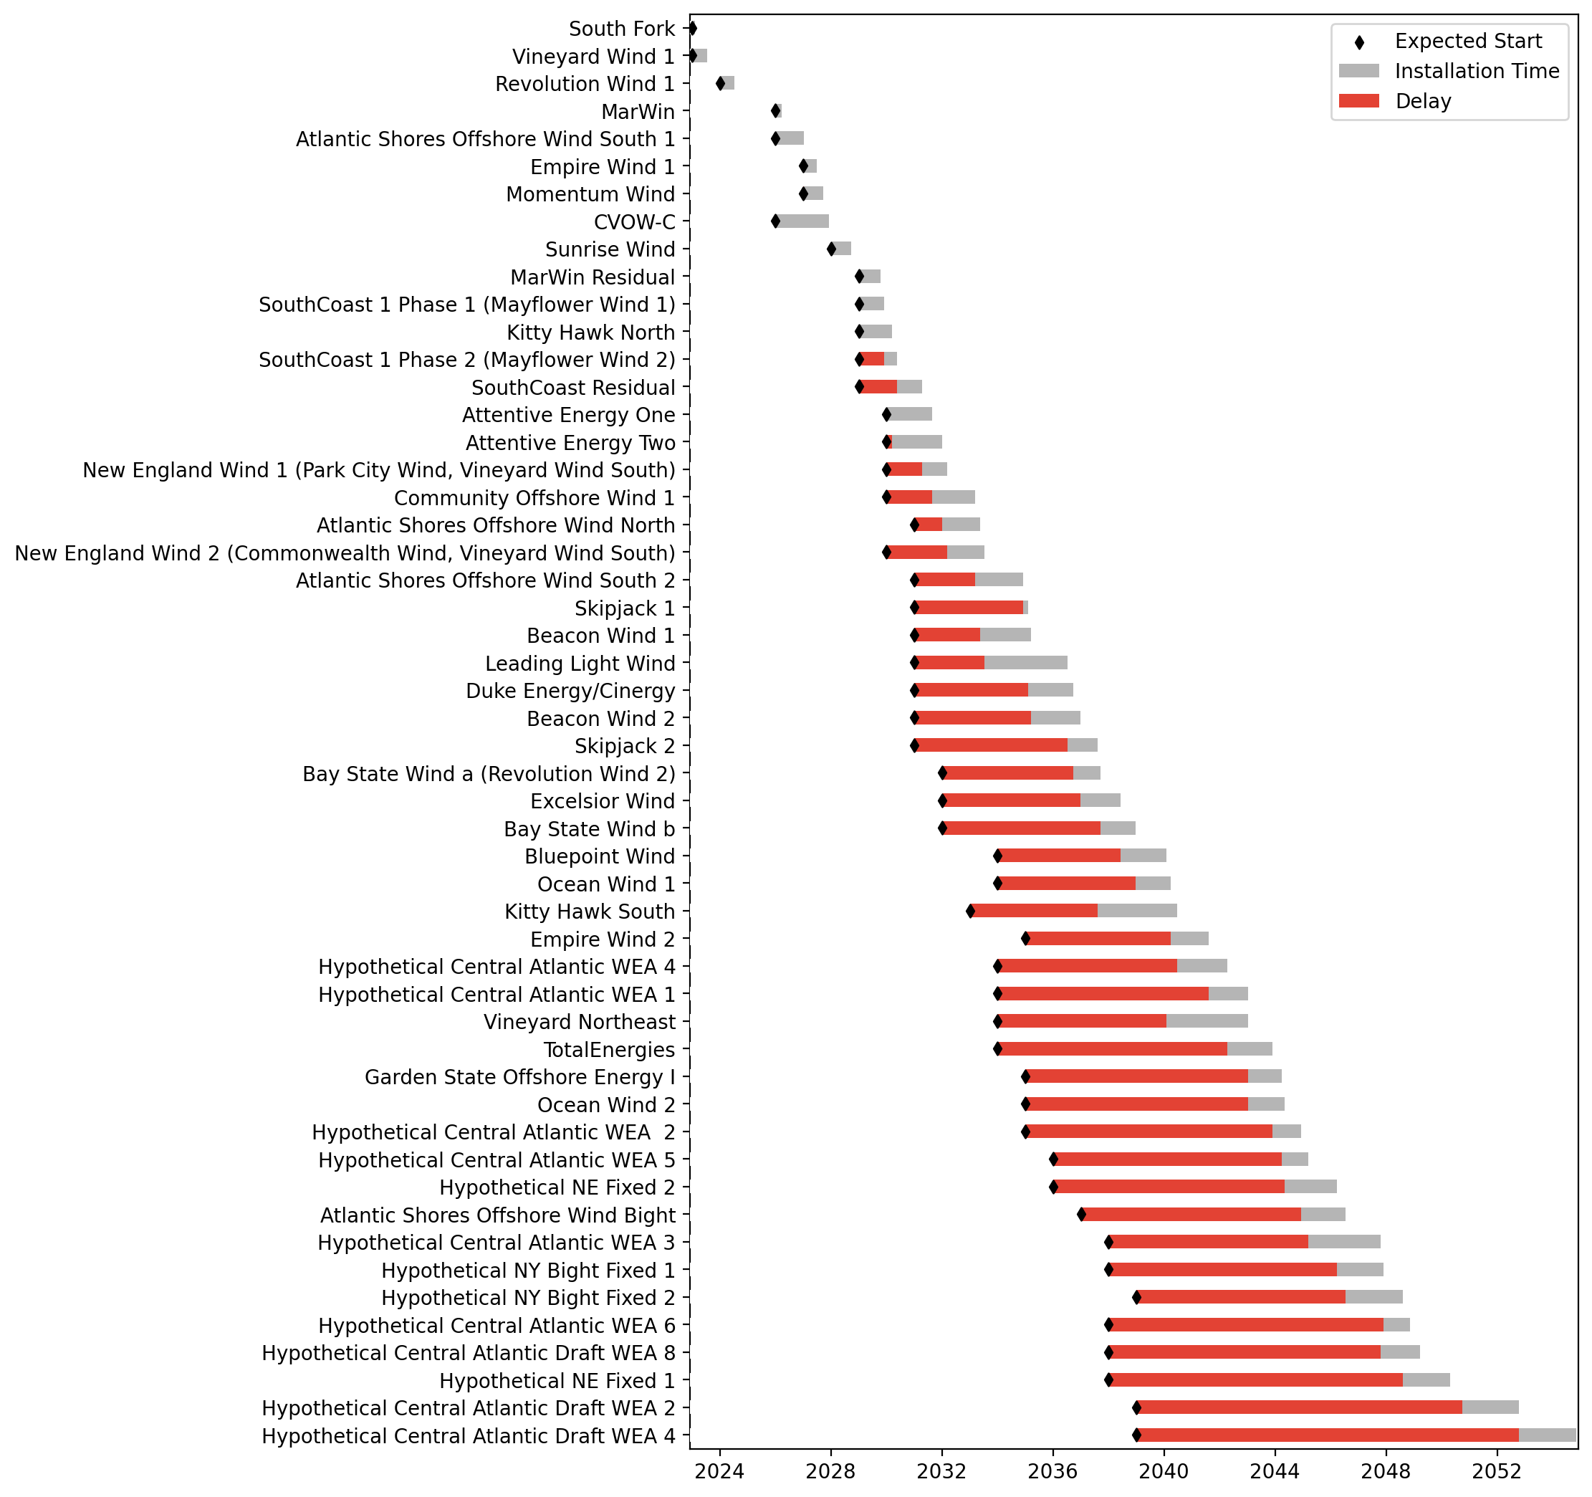
Fixed Gantt

Slide 28
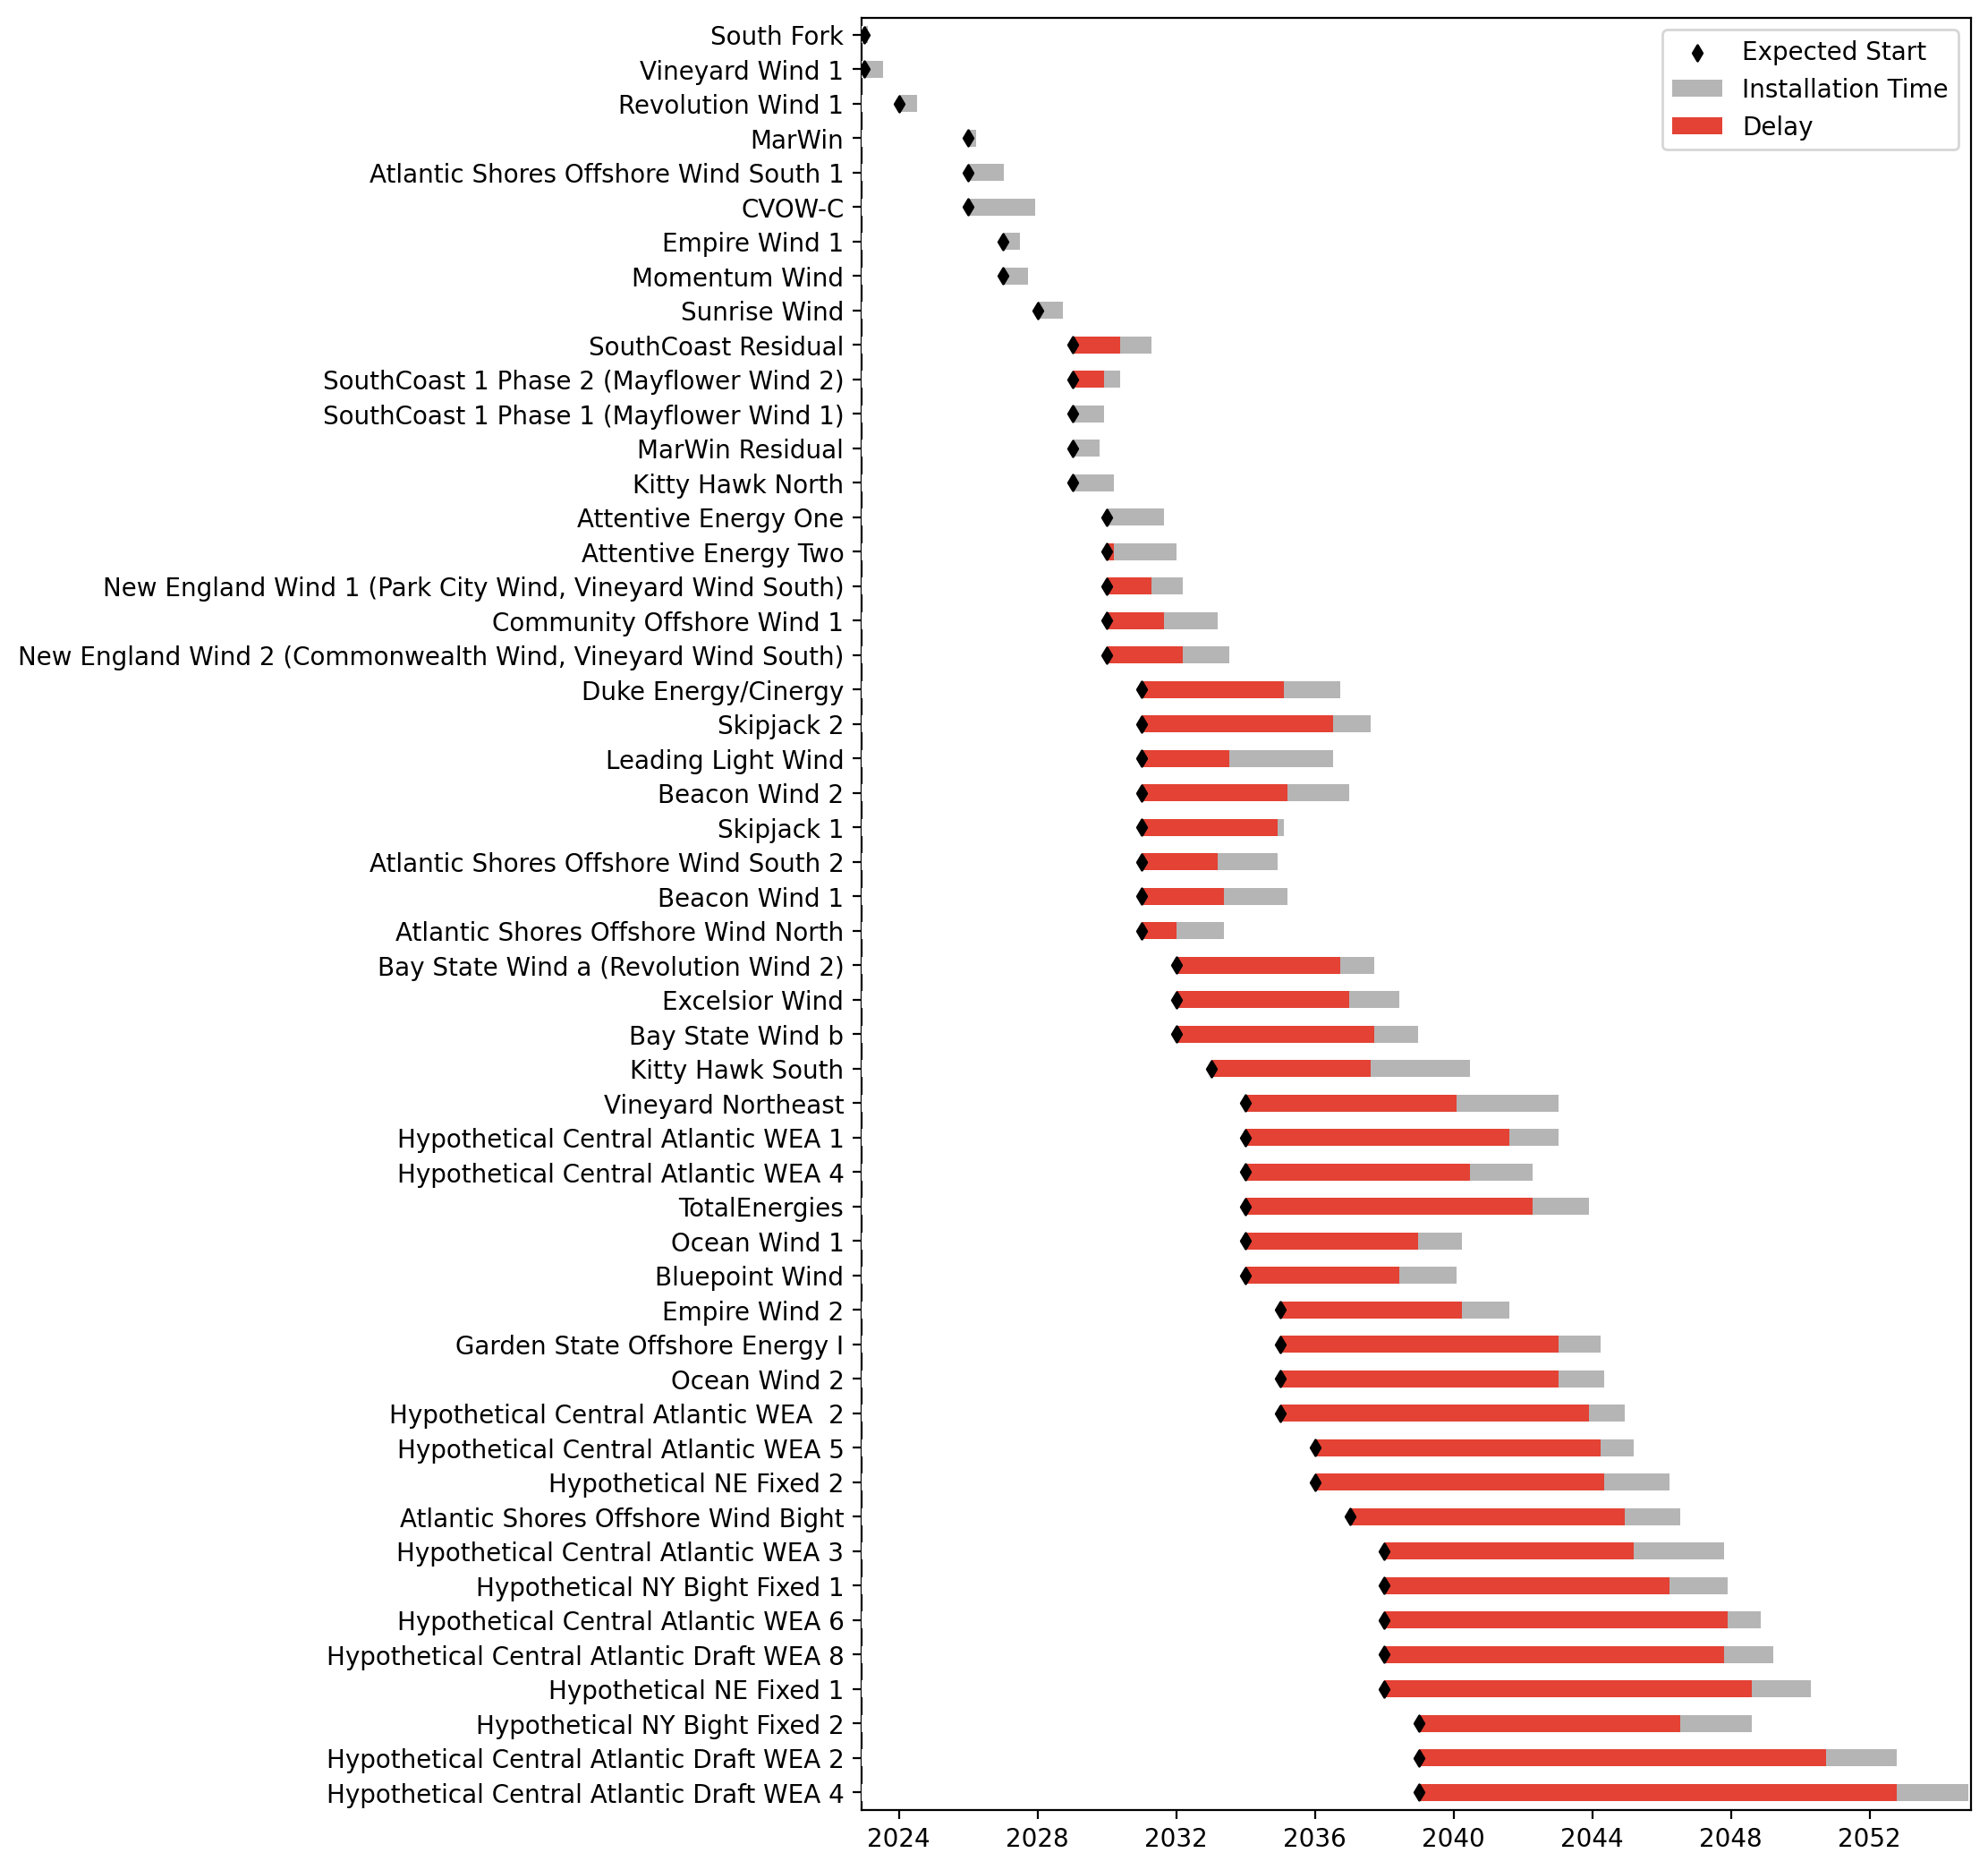
Sorted Fixed Gantt

Slide 29
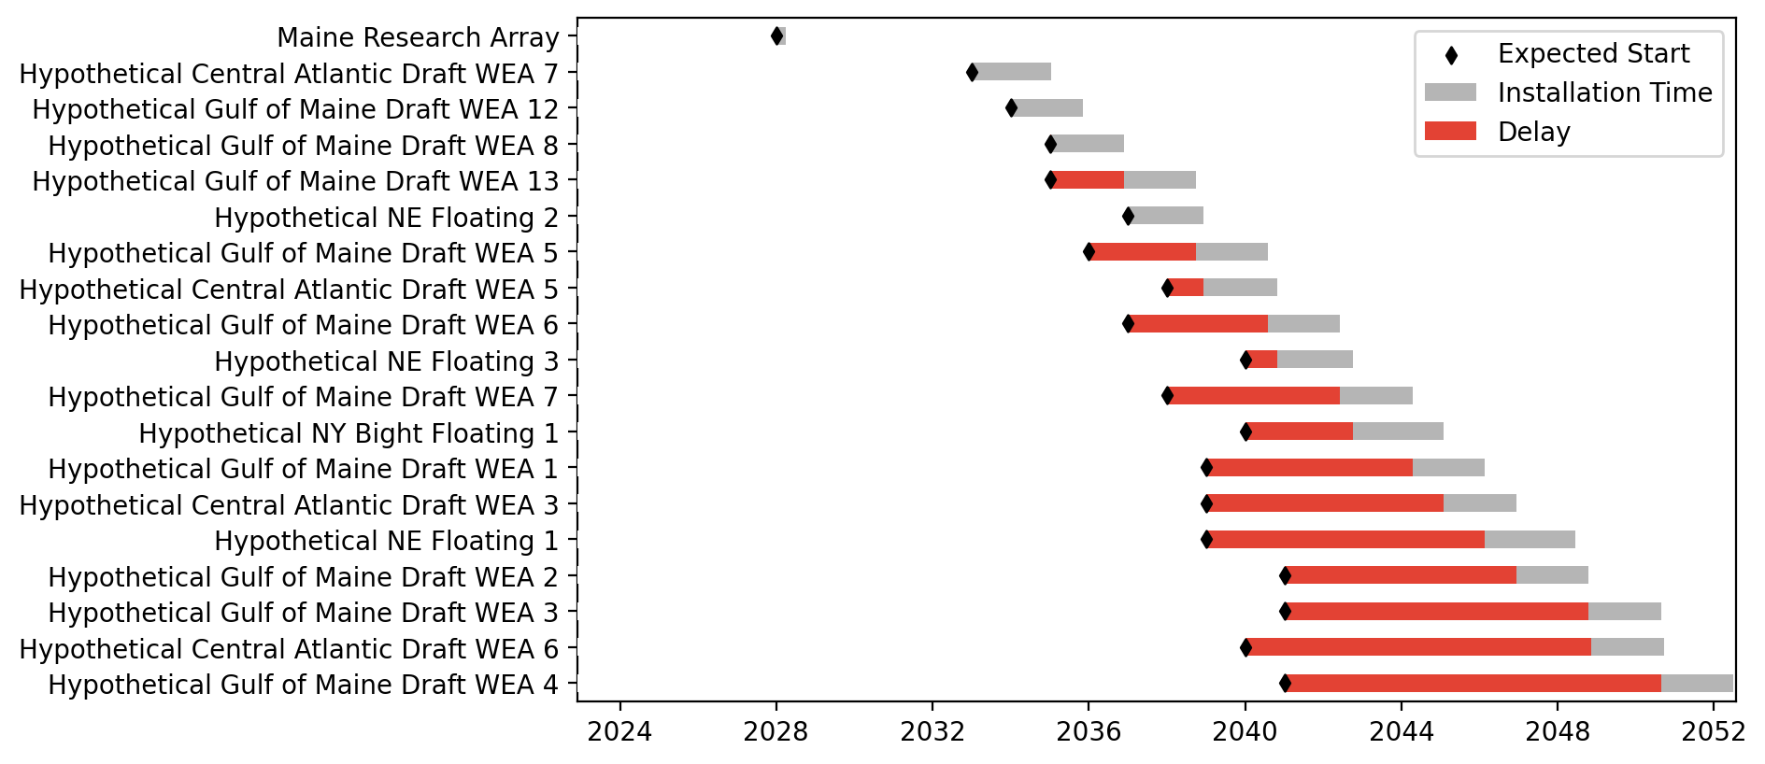
Floating Gantt

Slide 30
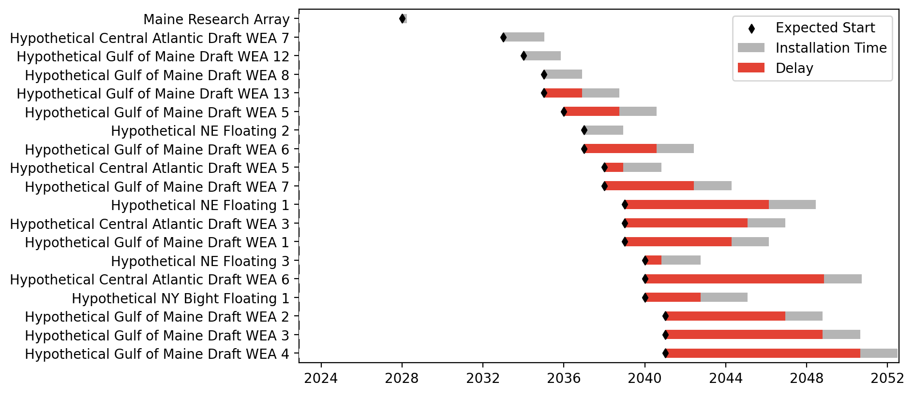
Sorted Floating Gantt

Slide 31
base_high
Pipeline: High
Vessel Pathway: Base
Port Pathway: Base

Slide 32
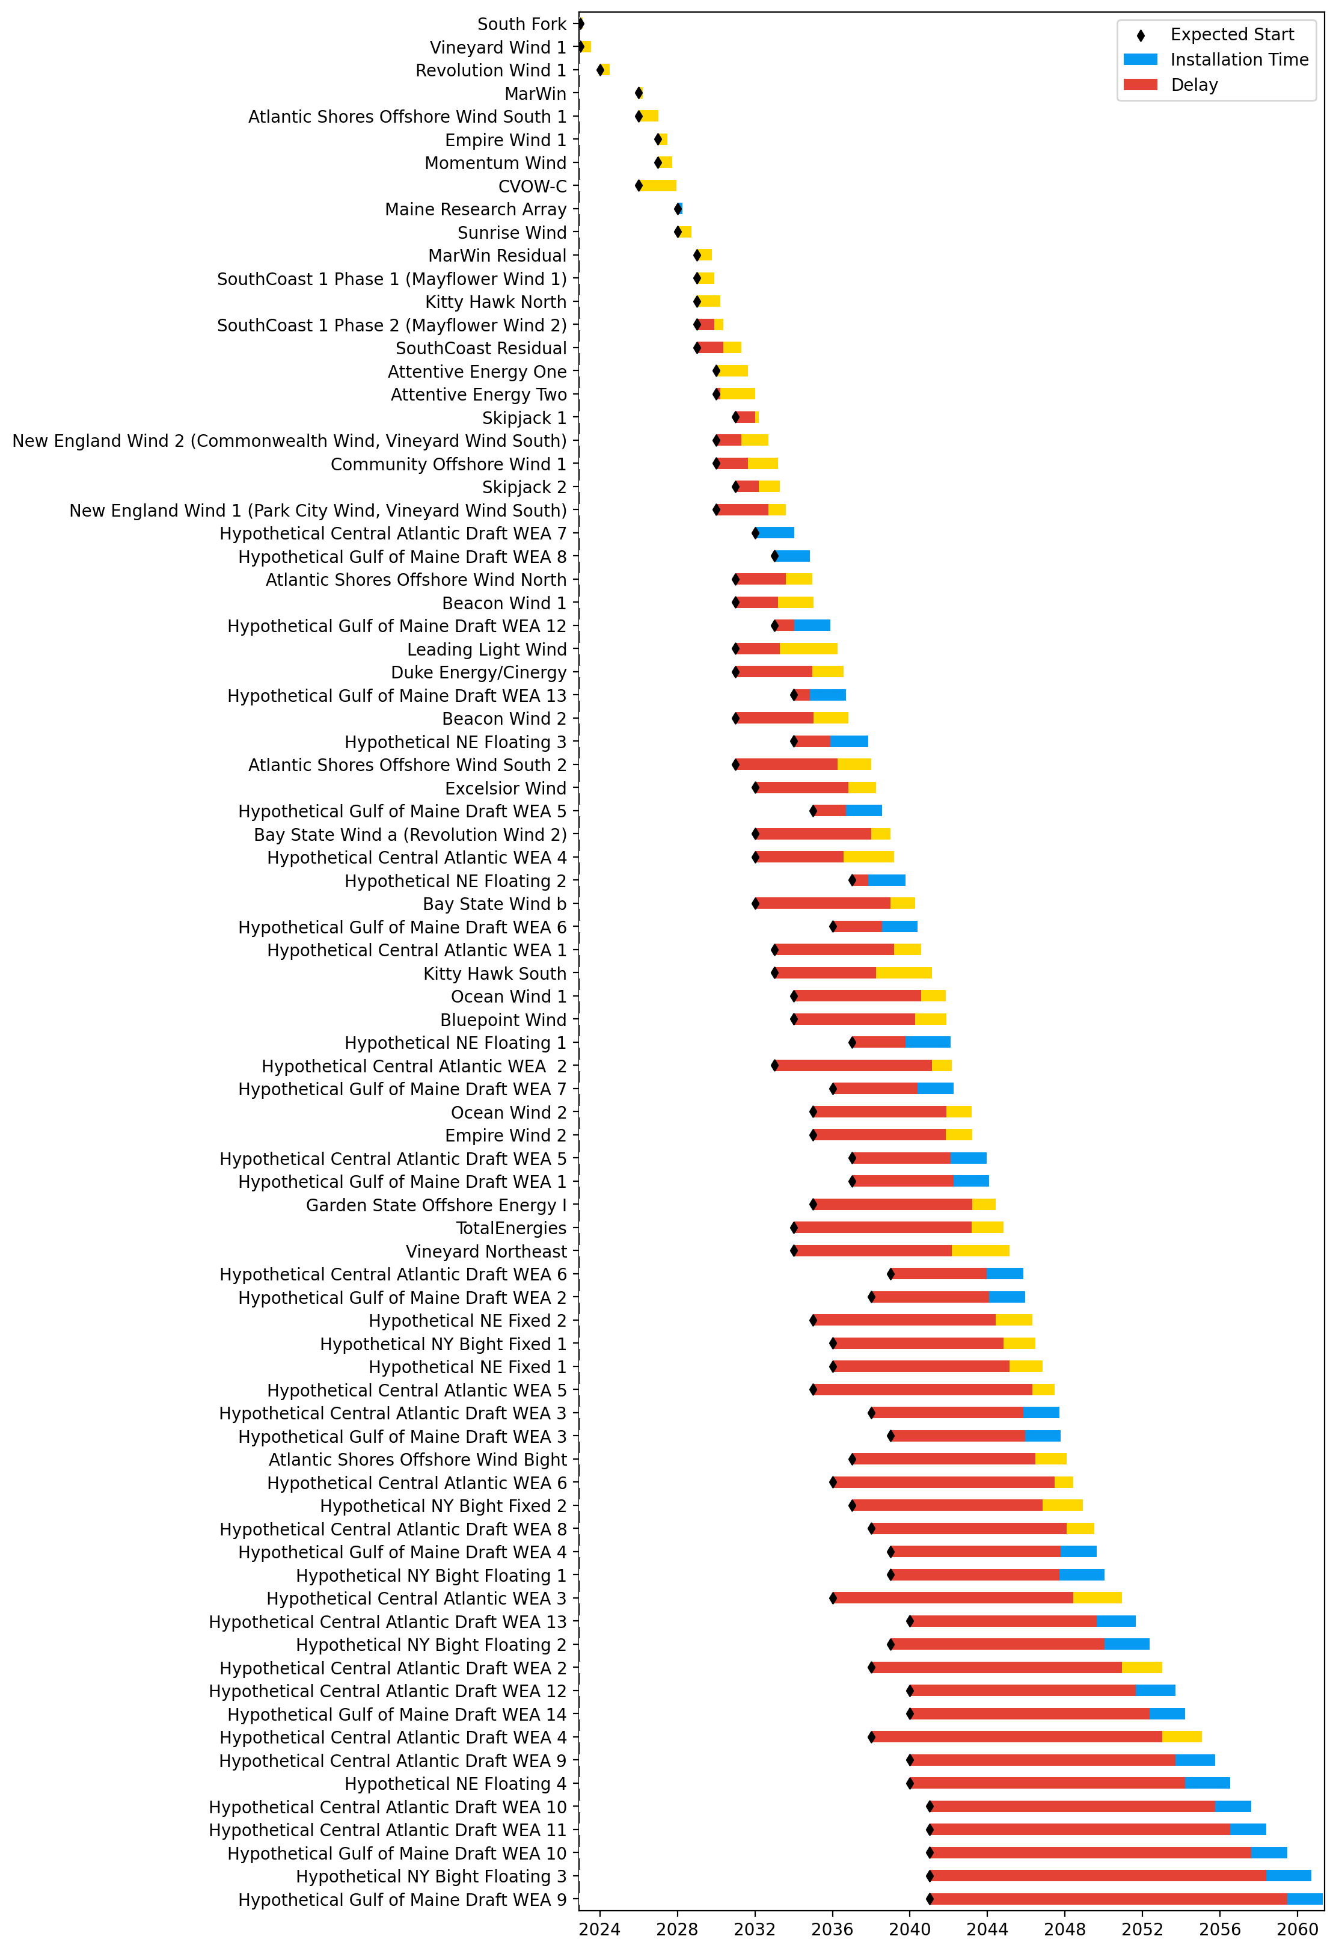
Full Gantt

Slide 33
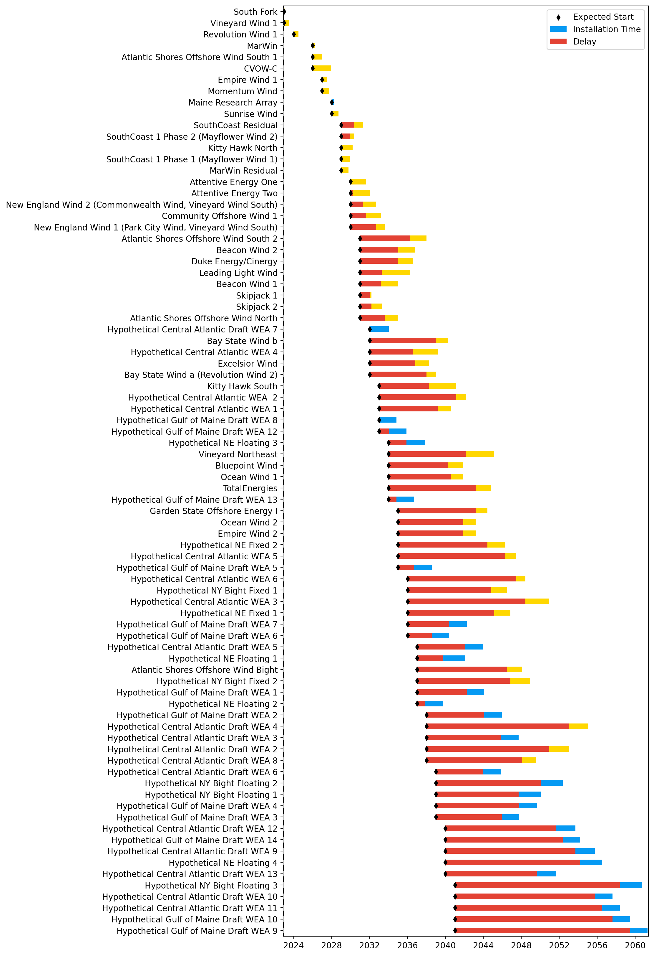
Sorted Full Gantt

Slide 34
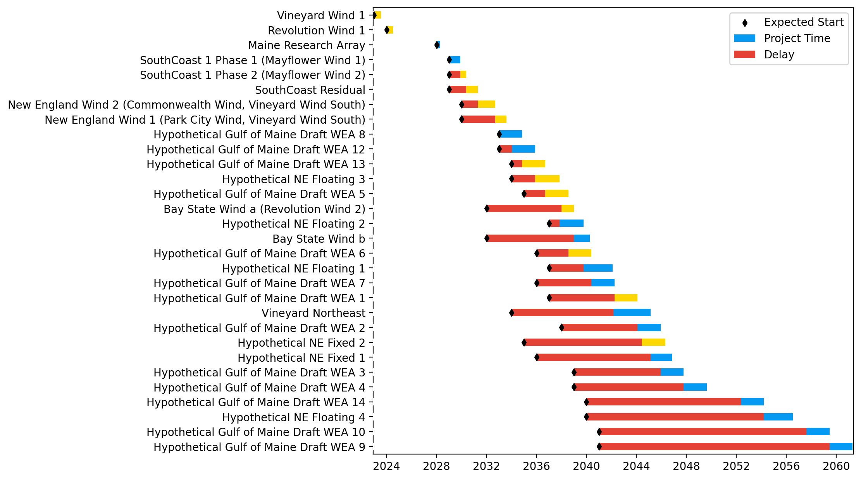
New England Gantt

Slide 35
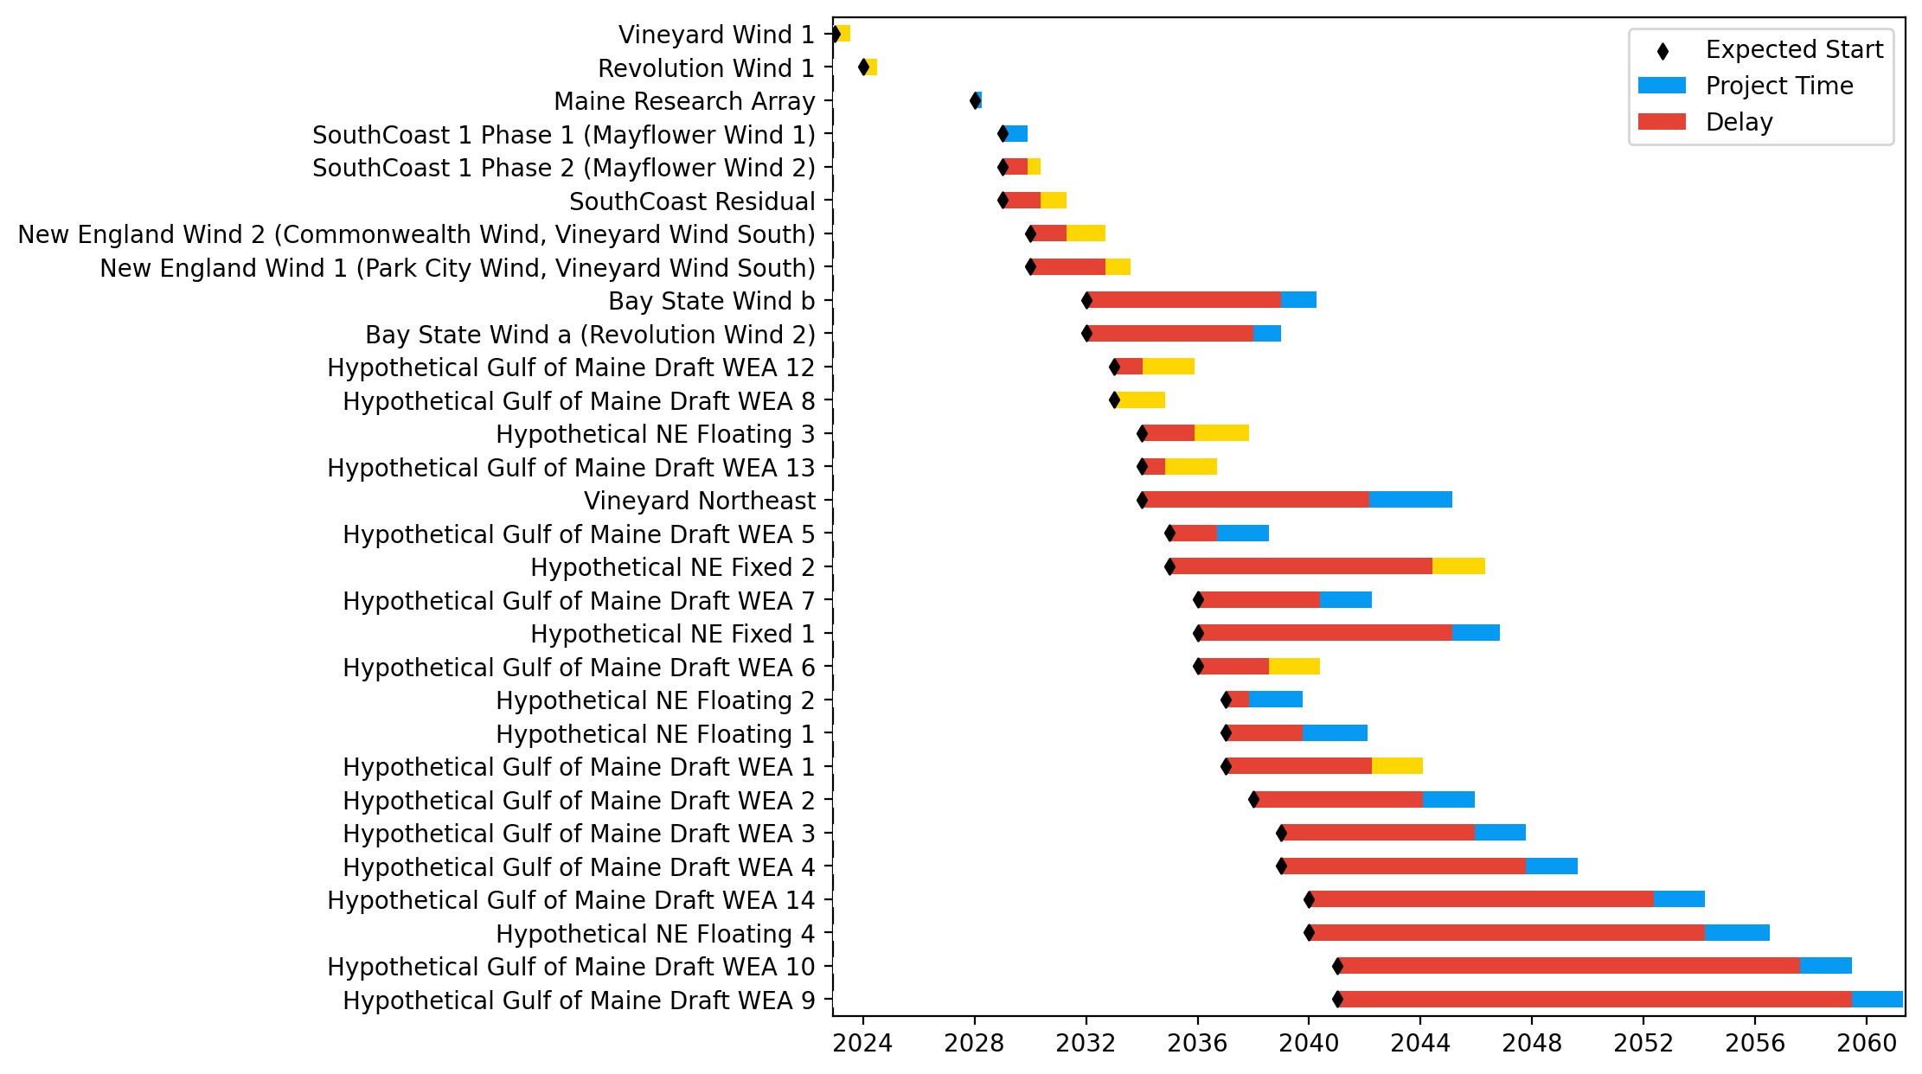
Sorted New England Gantt

Slide 36
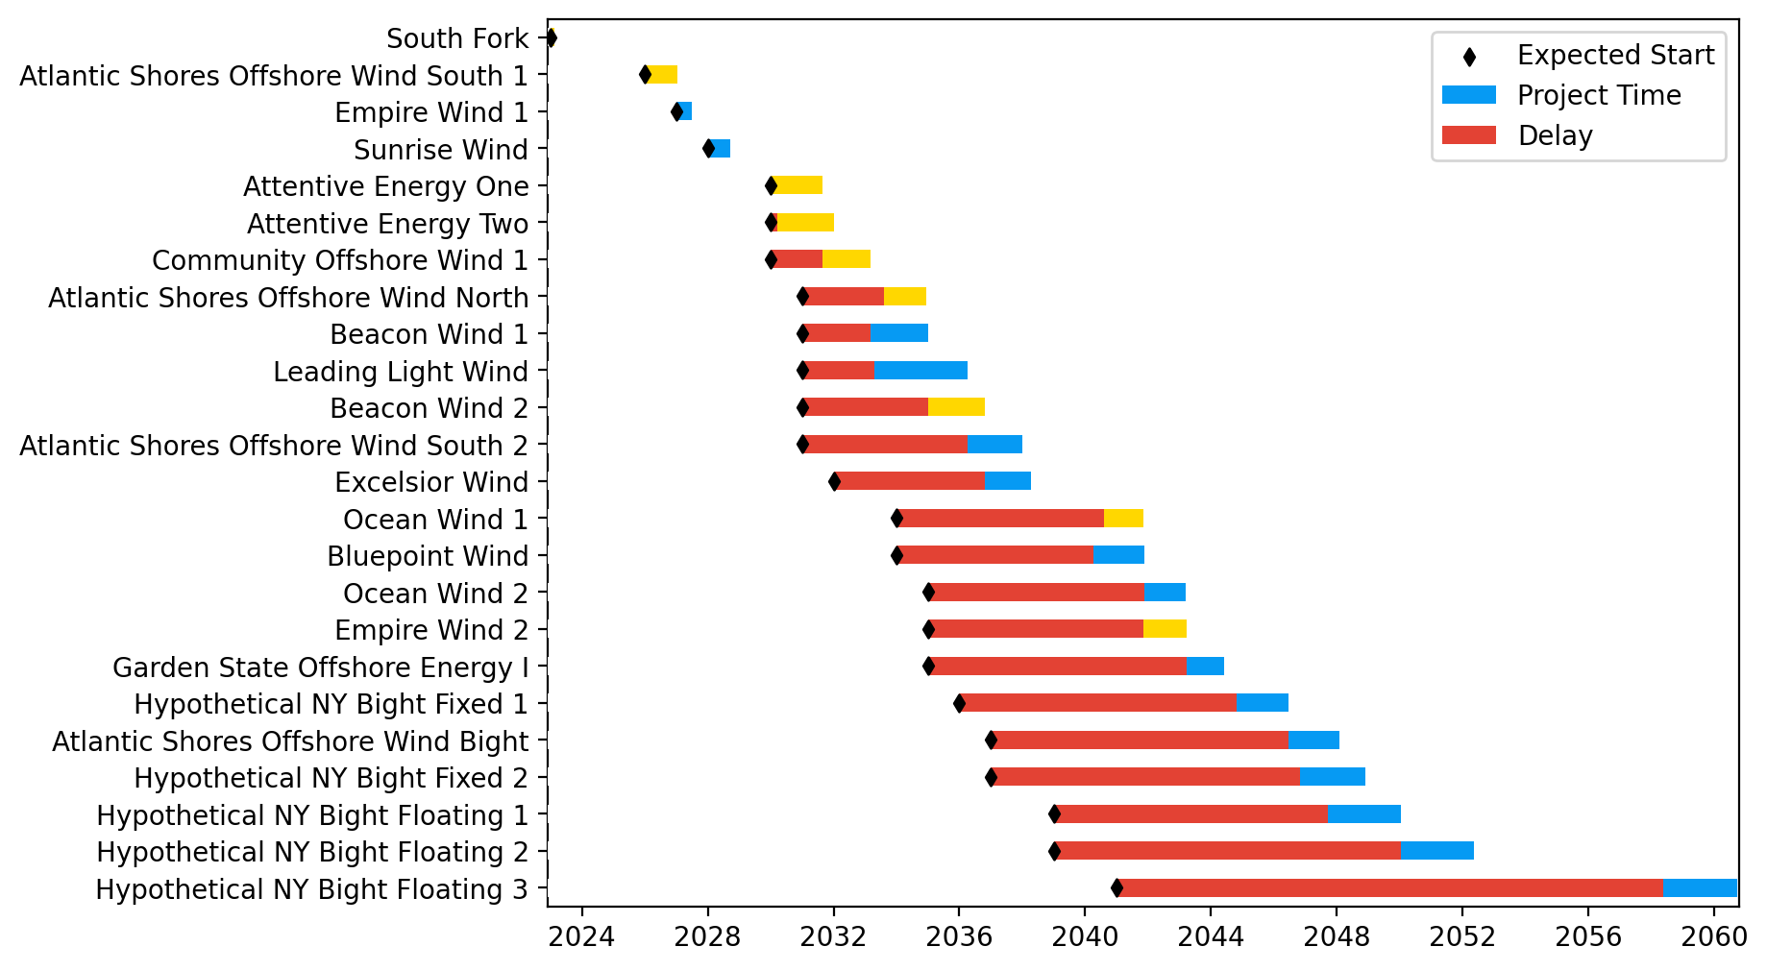
New York/New Jersey Gantt

Slide 37
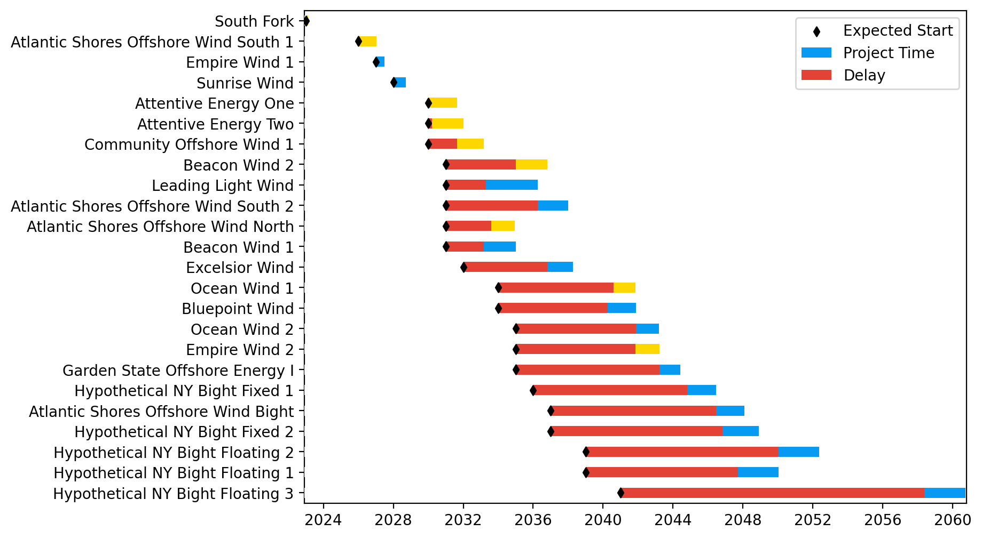
Sorted New York/New Jersey Gantt

Slide 38
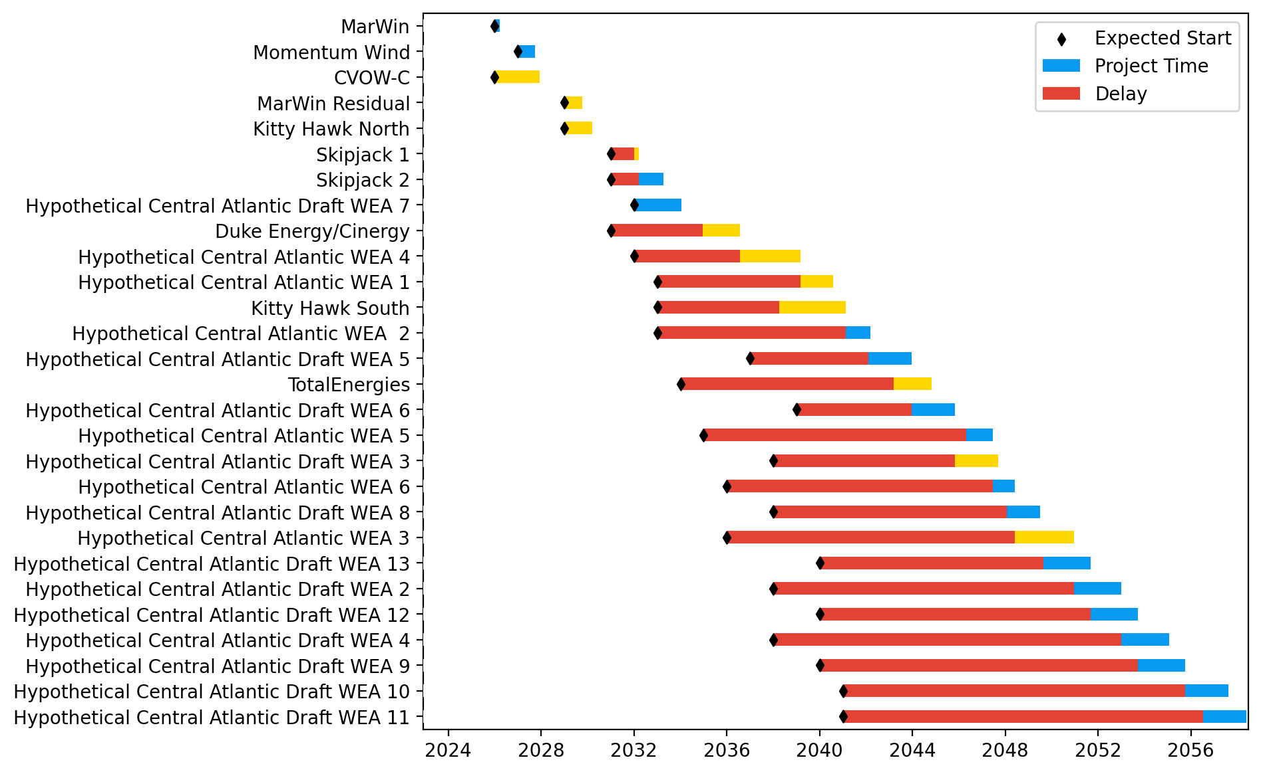
Midatlantic Gantt

Slide 39
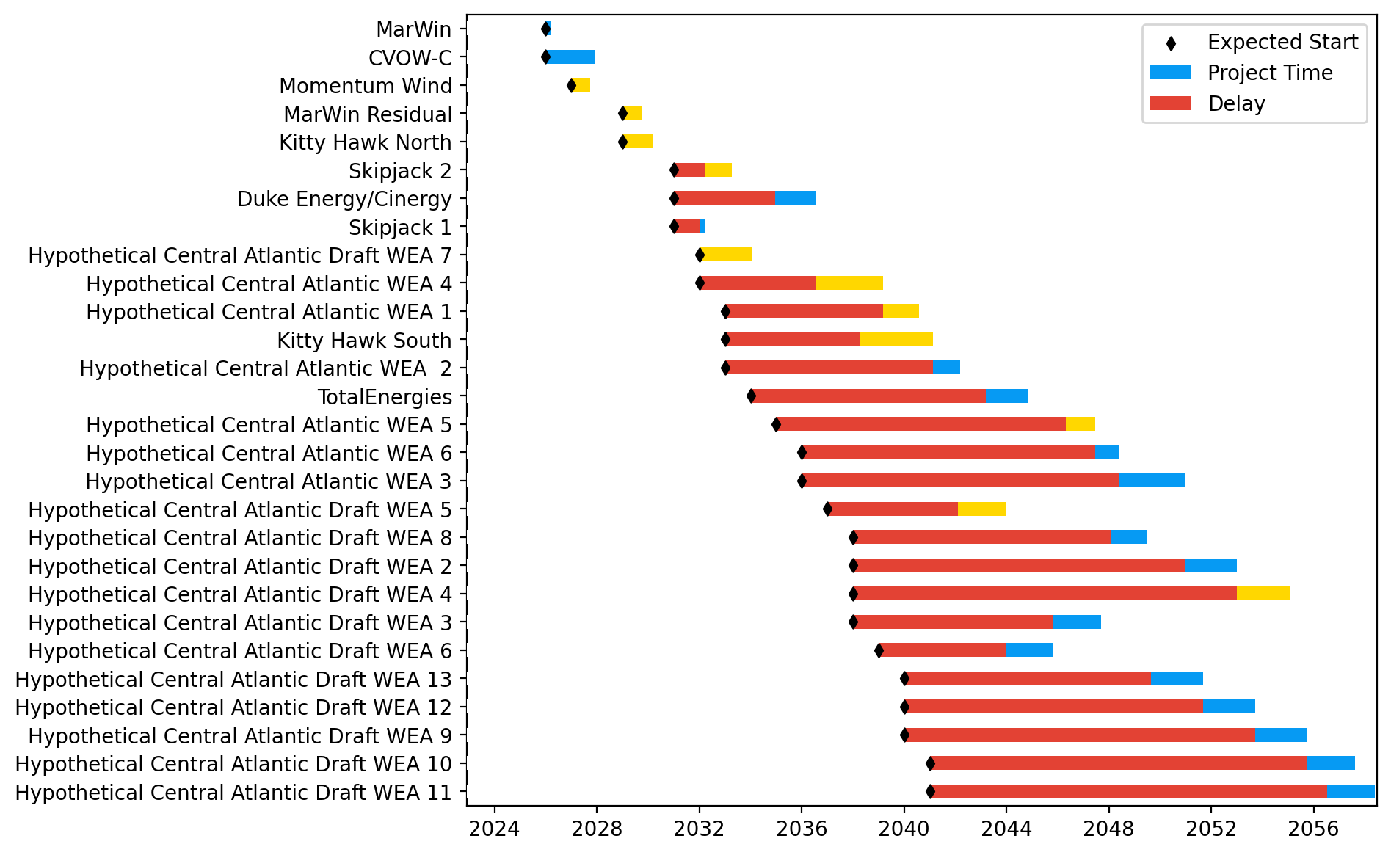
Sorted Midatlantic Gantt

Slide 40
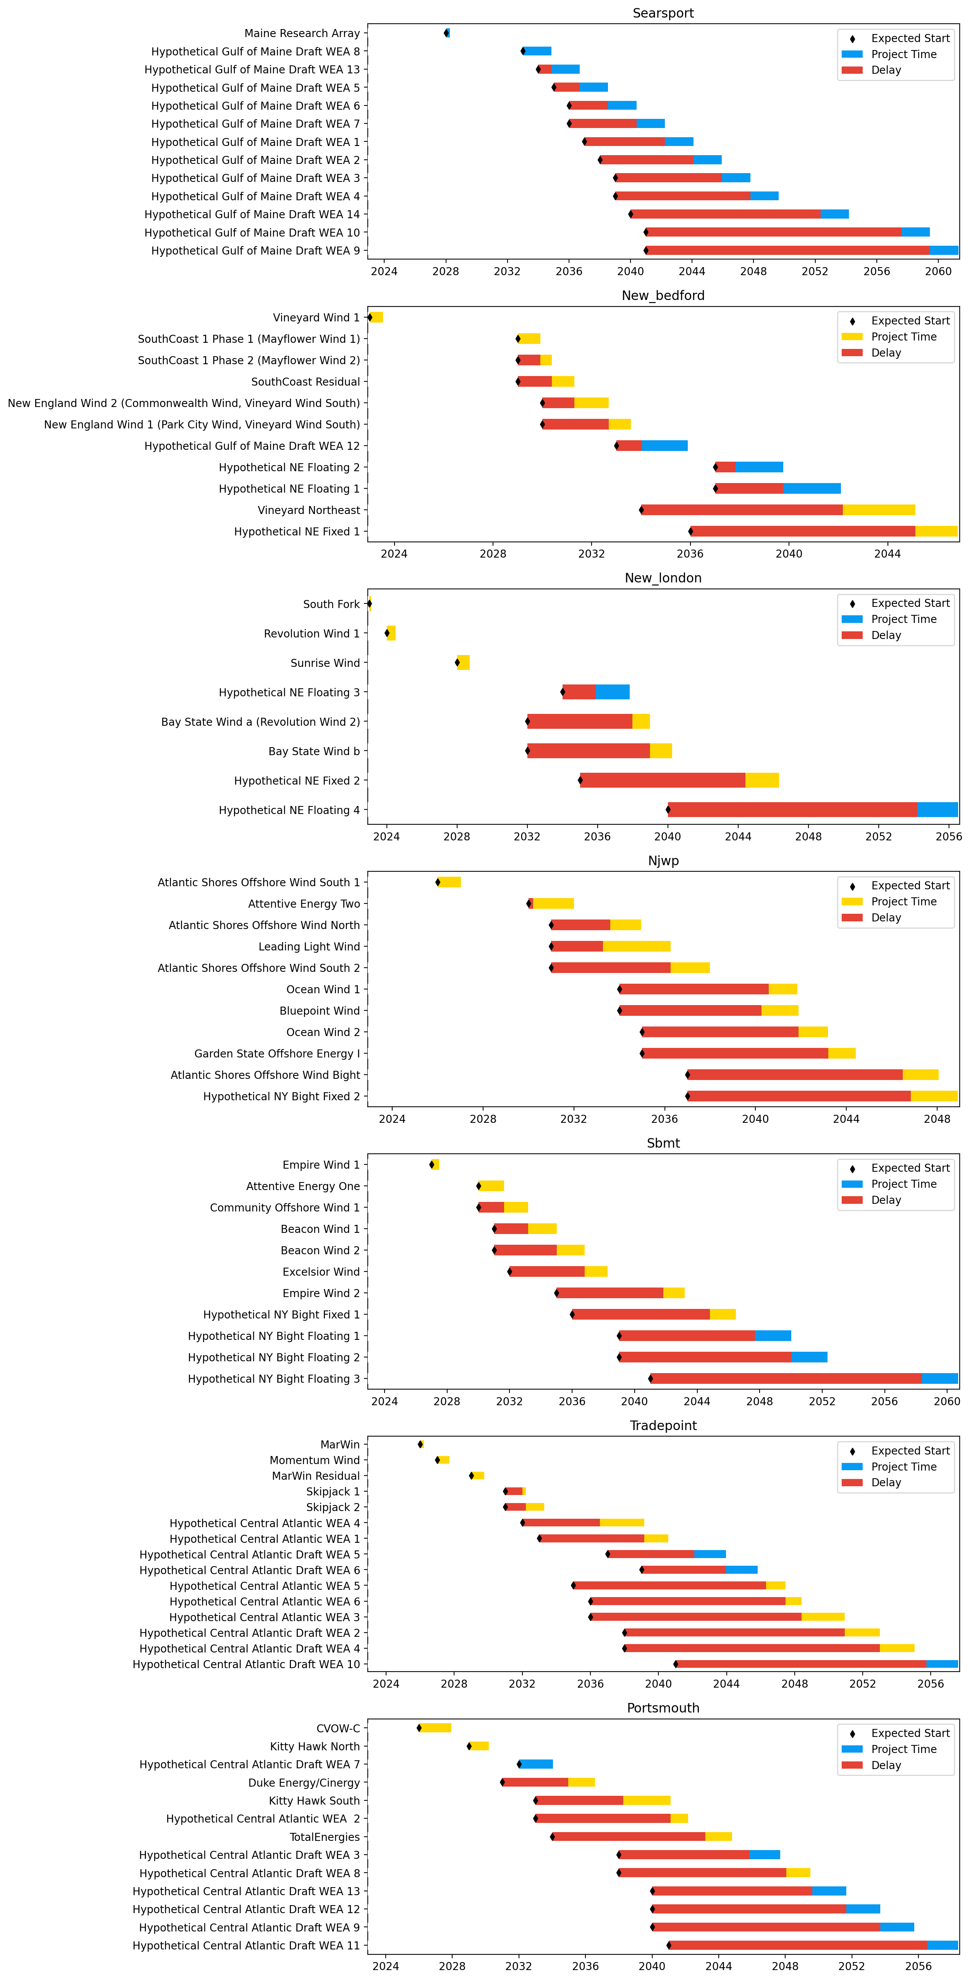
Port Gantts

Slide 41
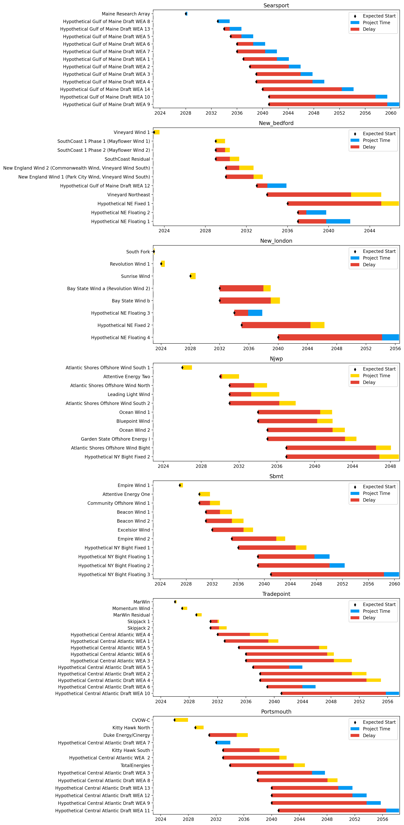
Sorted Port Gantts

Slide 42
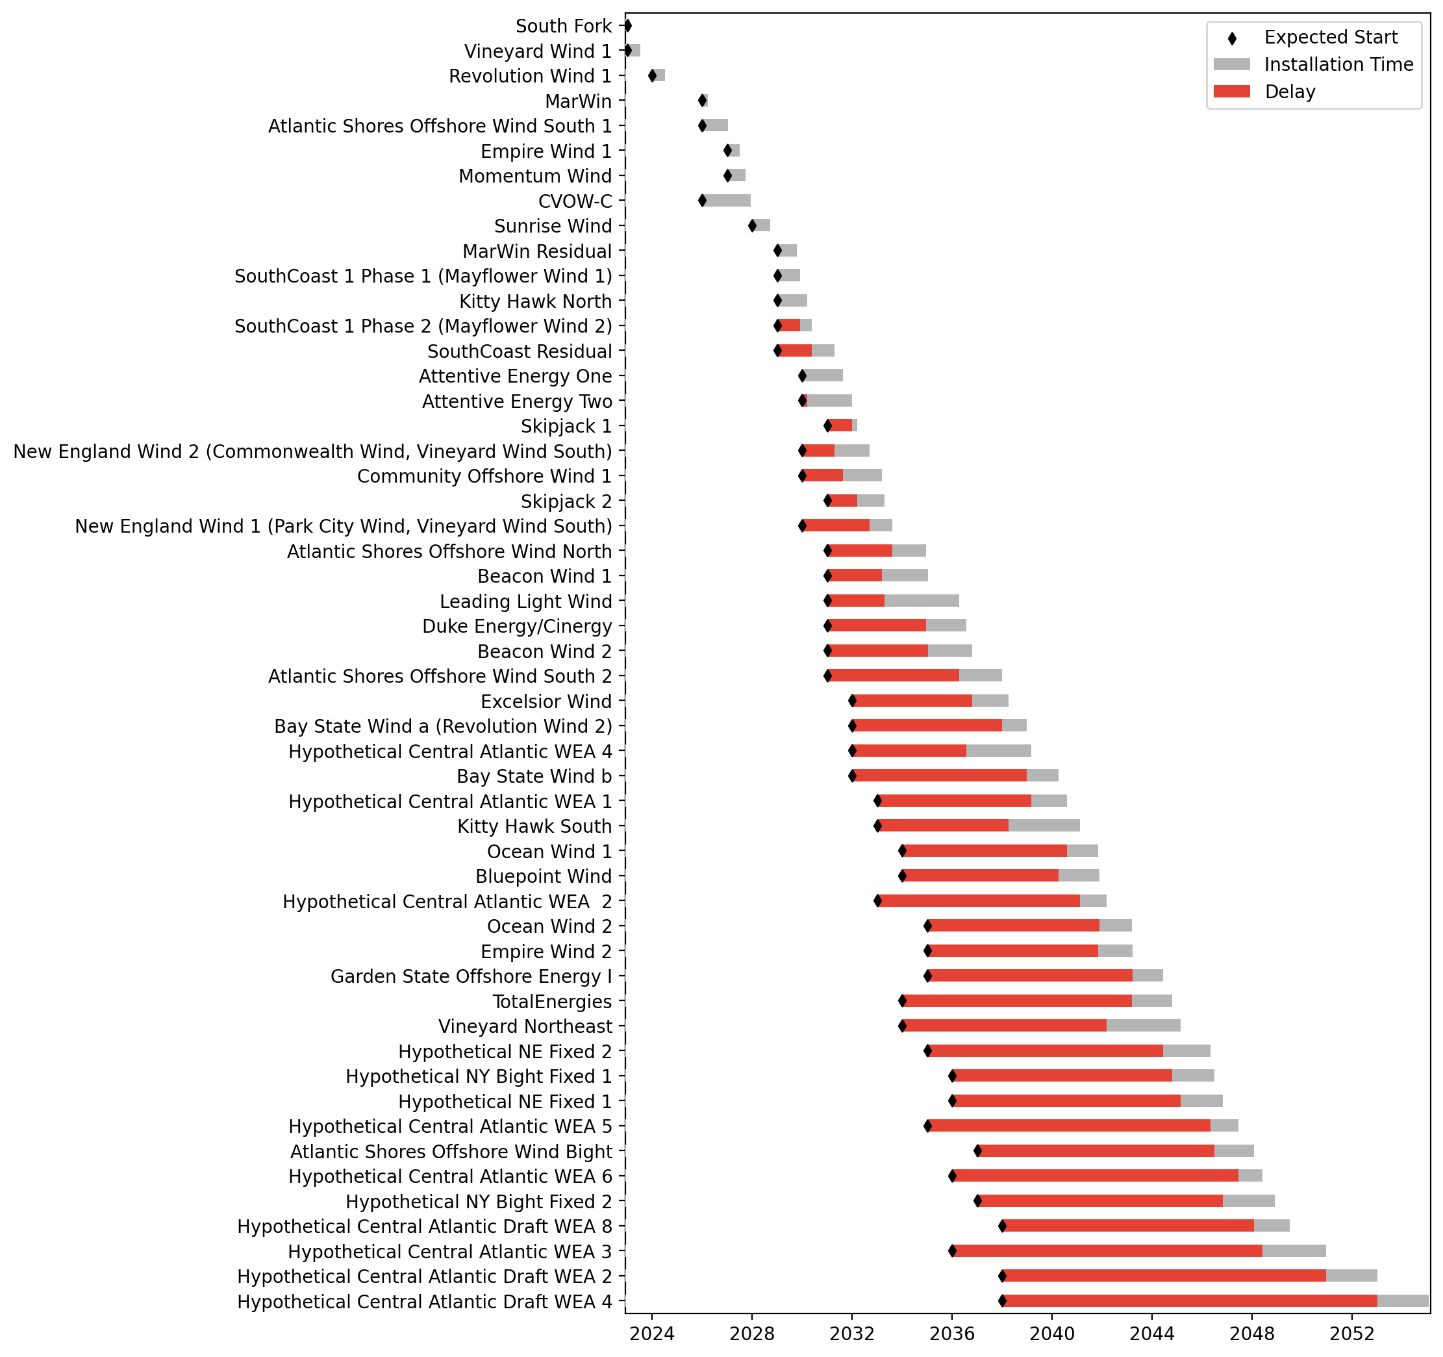
Fixed Gantt

Slide 43
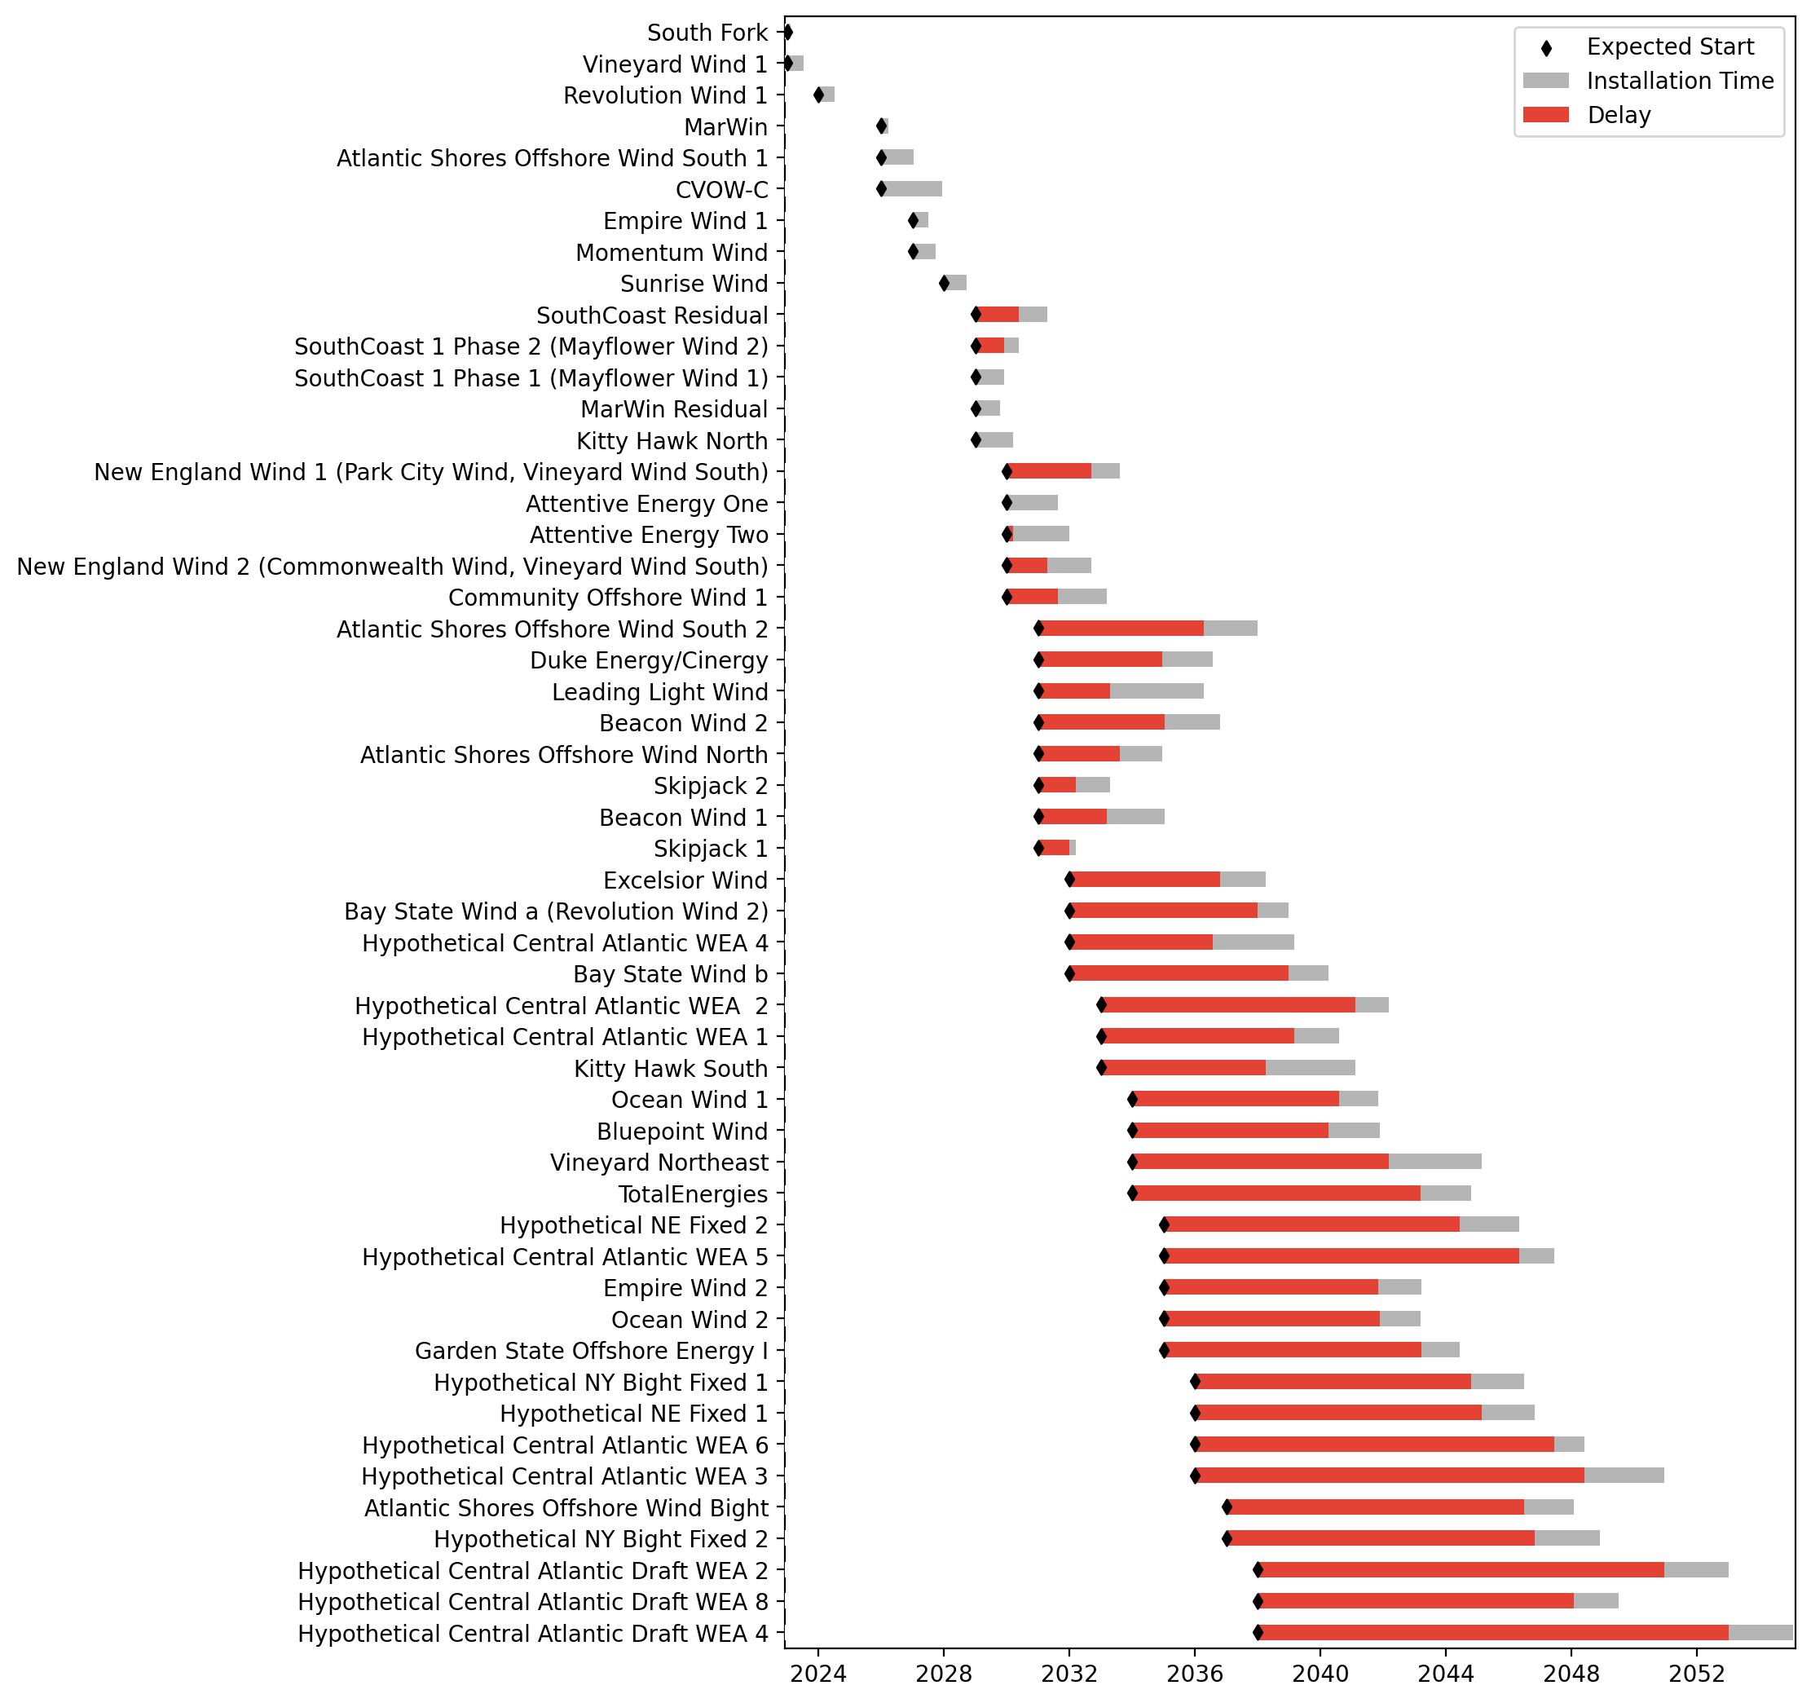
Sorted Fixed Gantt

Slide 44
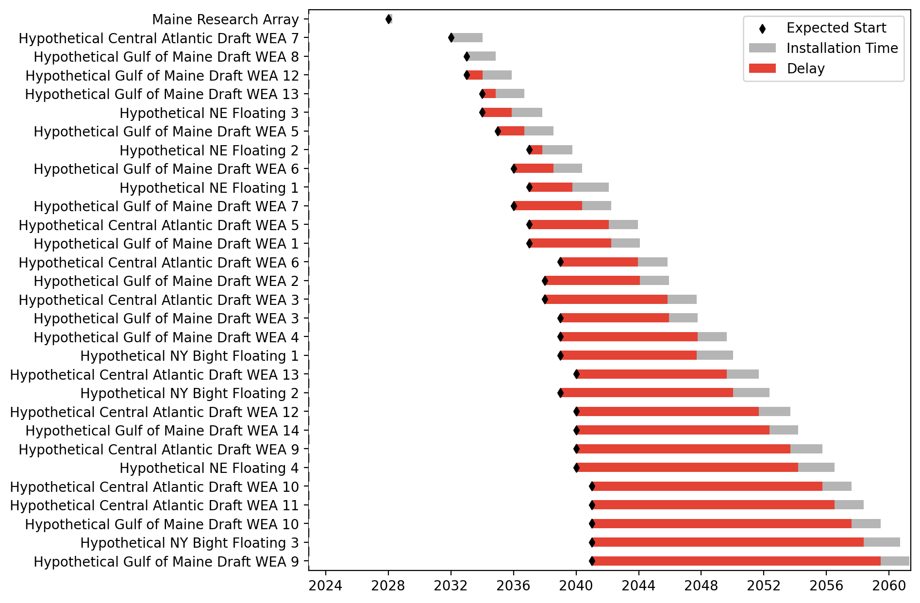
Floating Gantt

Slide 45
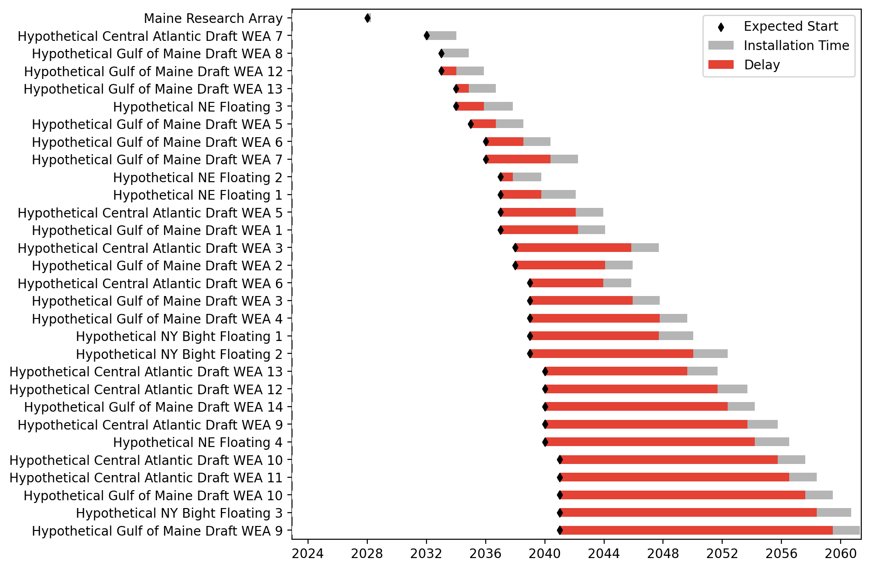
Sorted Floating Gantt

Slide 46
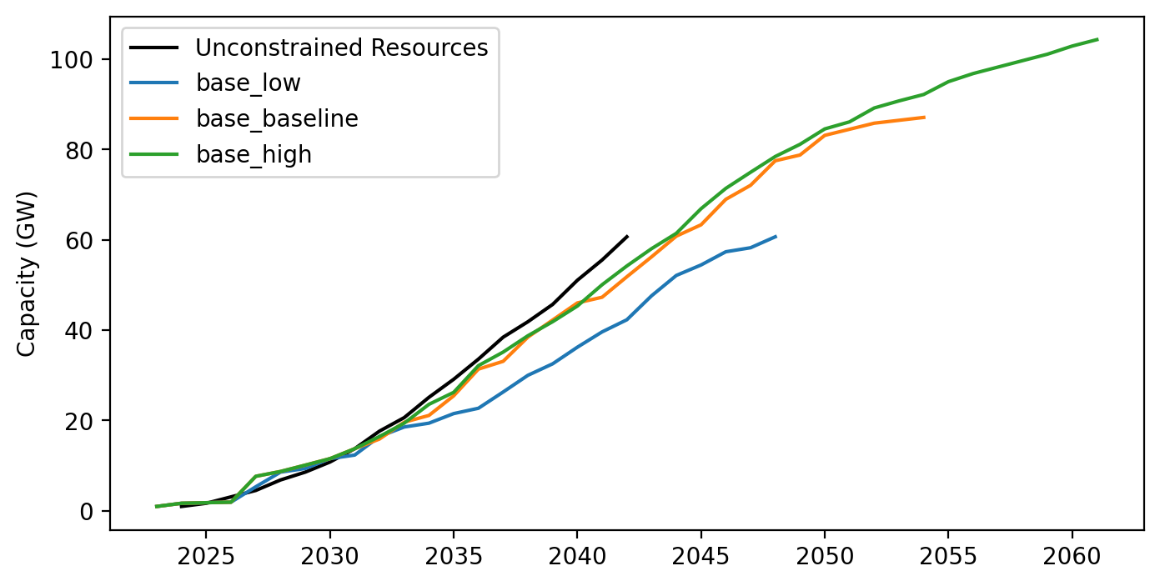
Cummulative Installed Capacity

